Slide 1
Indirect Wind-Field Estimation by UAV:
Drone Simulation
Written By: Kunal Deshmukh
Advisor: Dr. Geordan Gutow

Slide 2
Contents
Variation in Material Density
Variation in Propeller Diameter
Variation in Propeller Thrust Constant
Variation in Motor Time Constant
Variation in drag coefficient (Cd) in X-direction
Variation in drag coefficient (Cd) in Pitching direction

Slide 3
Variation in Material Density

Slide 4
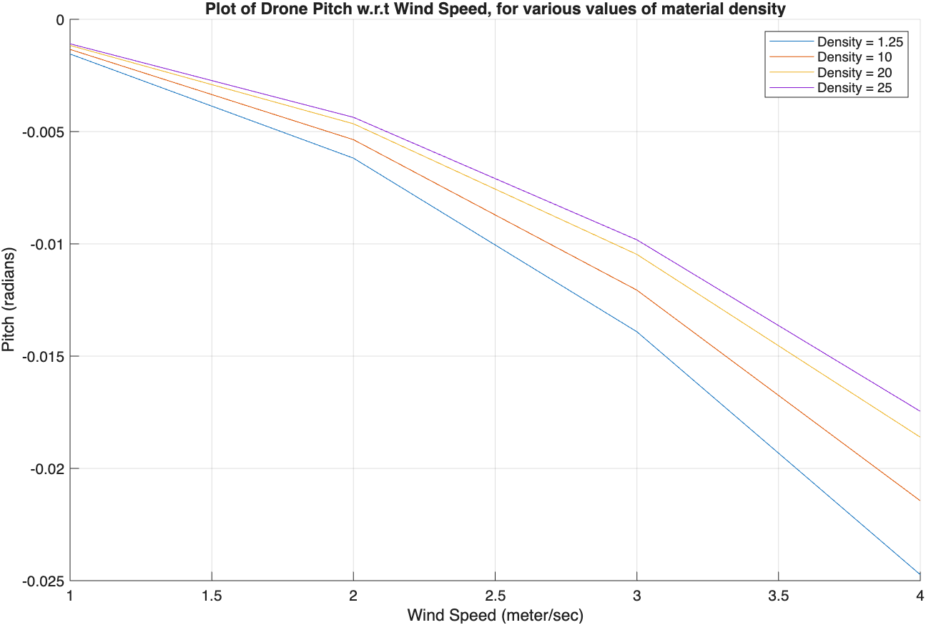
Sensitivity of Drone Pitch to Material Density
The absolute pitch angle of the drone decreases with increase in the material density of the drone; for a given value of wind speed.
The absolute pitch angle of the drone increases, with an increase in the wind speed – for a given density of drone material.

Slide 5
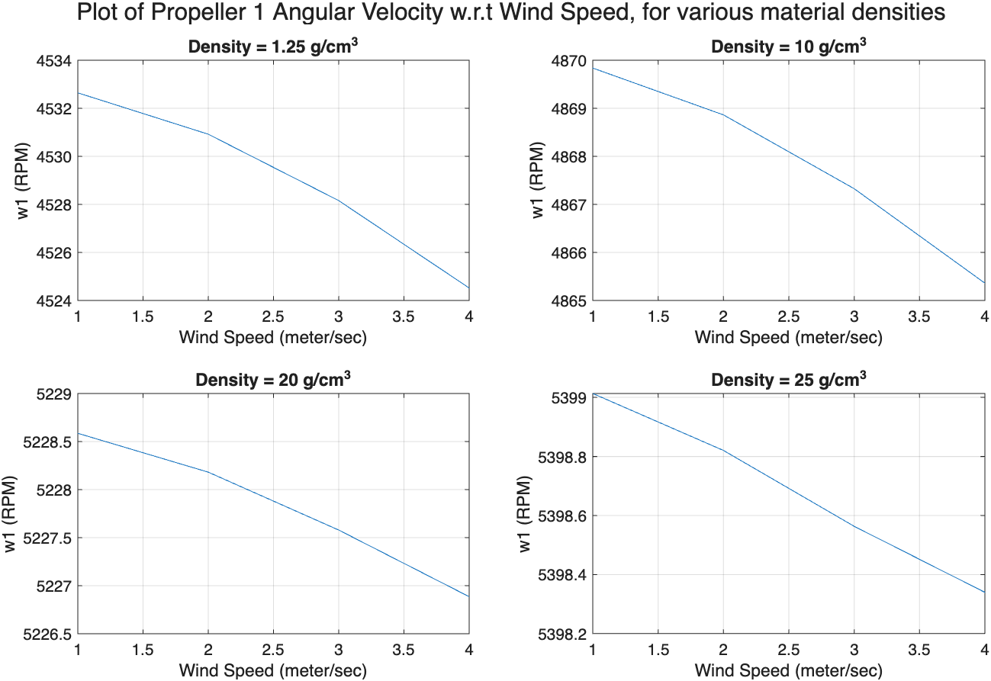
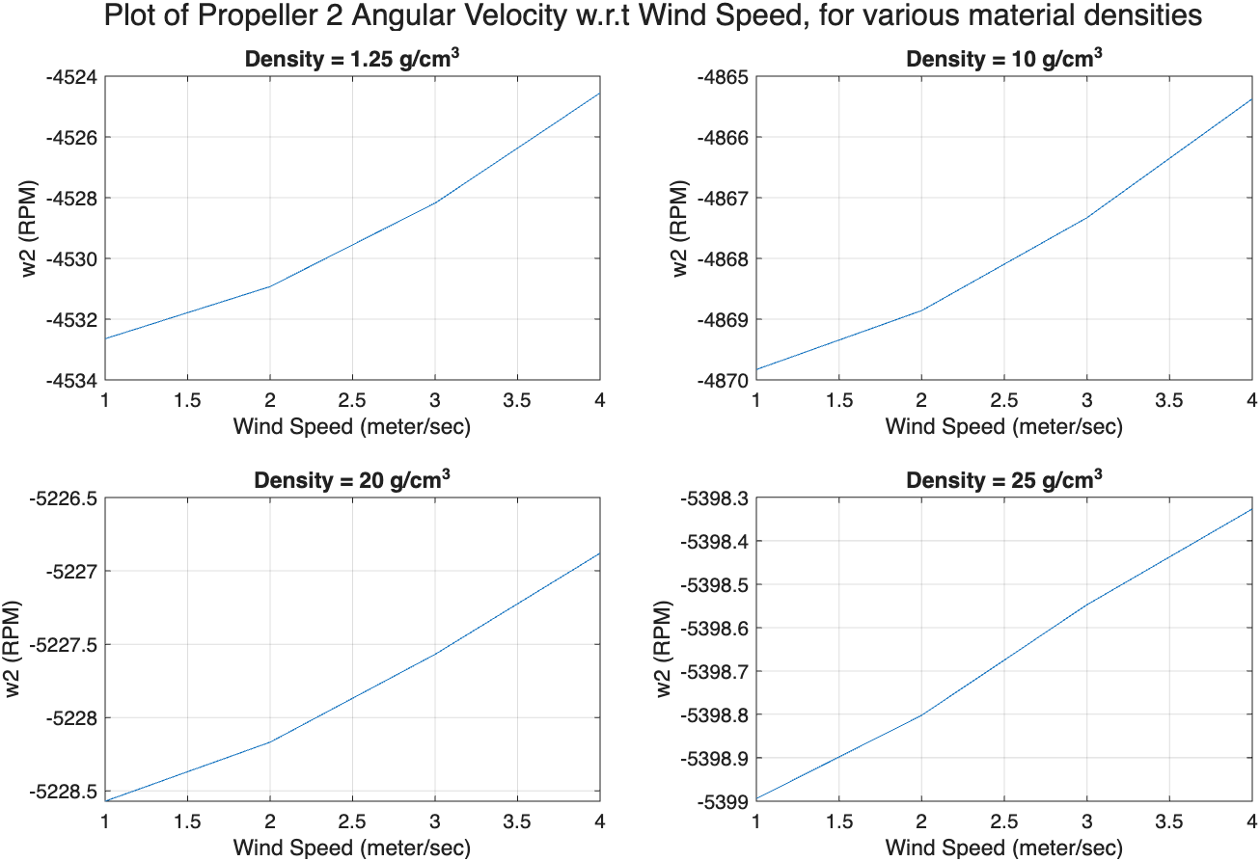
Sensitivity of Angular Velocity of Propeller 1 and Propeller 2 to Material Density
The absolute angular velocity of propeller 1 and 2 decreases with an increase in wind velocity.
However, the absolute angular velocity of propeller 1 and 2 increases, with an increase in material density.

Slide 6
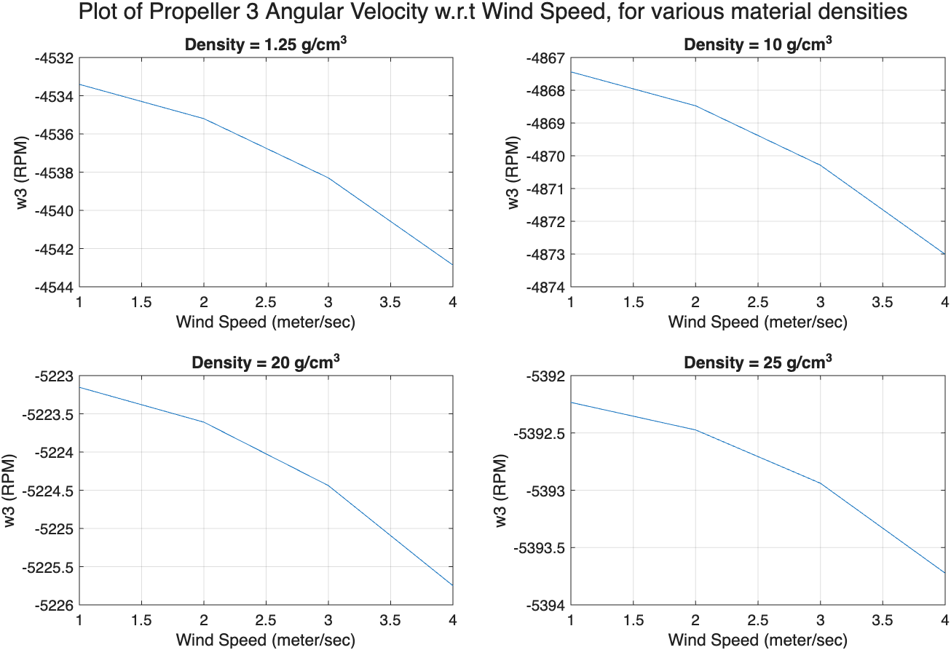
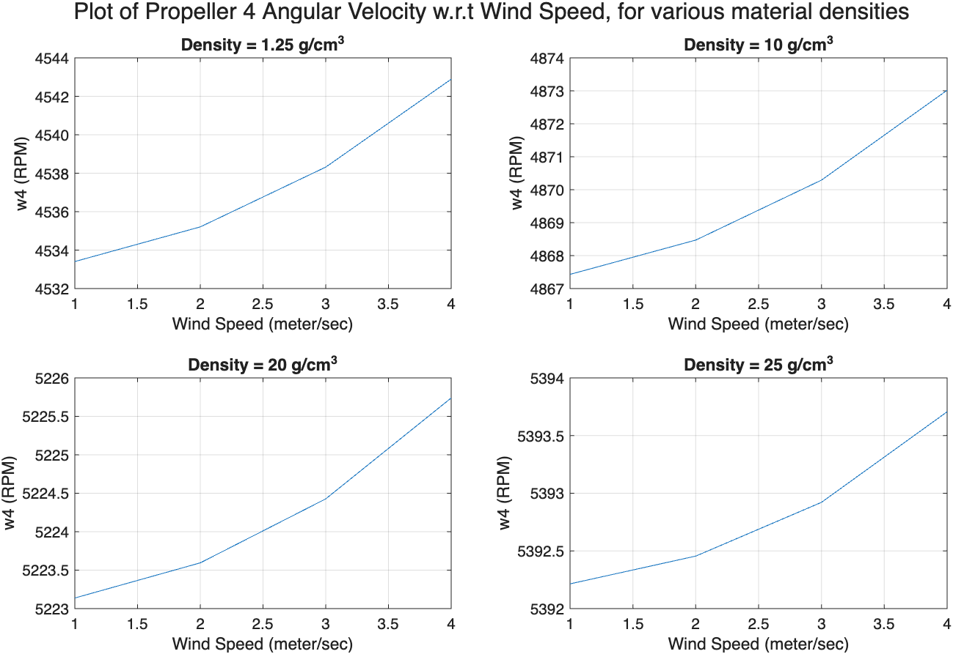
Sensitivity of Angular Velocity of Propeller 3 and Propeller 4 to Material Density
The absolute angular velocity of propeller 3 and 4 increases with an increase in wind velocity.
Also, the absolute angular velocity of propeller 3 and 4 increases, with an increase in material density.

Slide 7
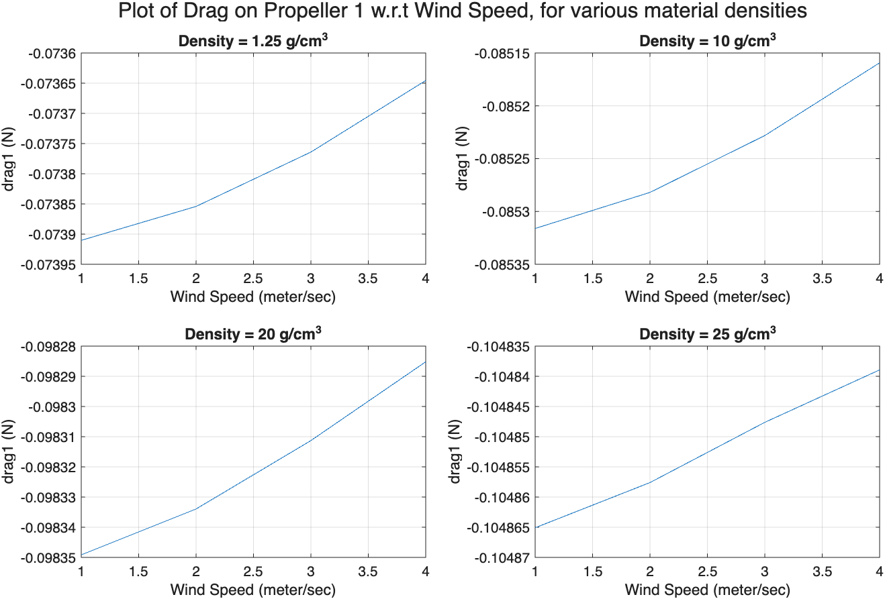
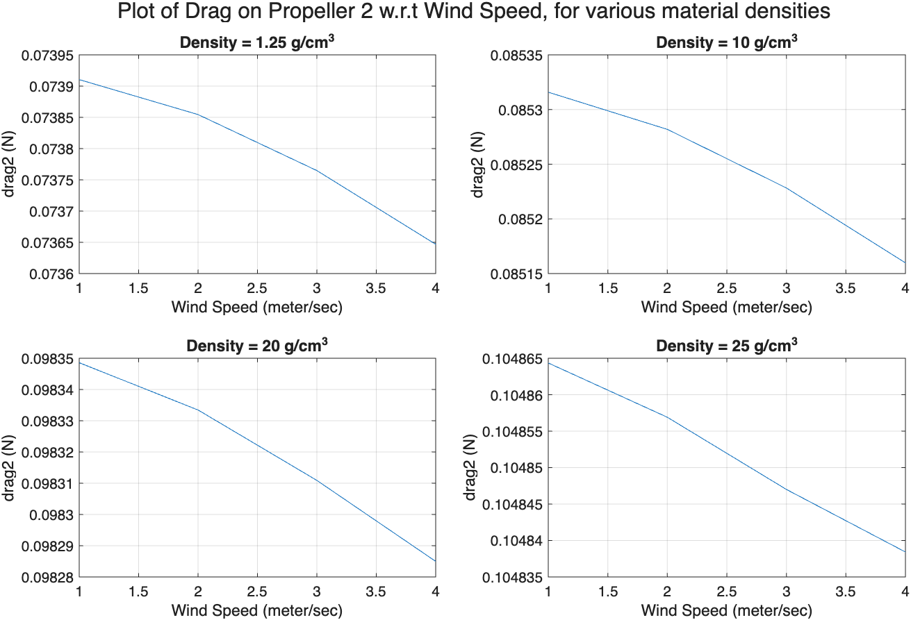
Sensitivity of Aerodynamic Drag on Propeller 1 and Propeller 2 to Material Density
The absolute value of drag force on blades of propeller 1 and 2 decreases with an increase in wind velocity.
However, the absolute drag force on propeller 1 and 2 increases, with an increase in material density.

Slide 8
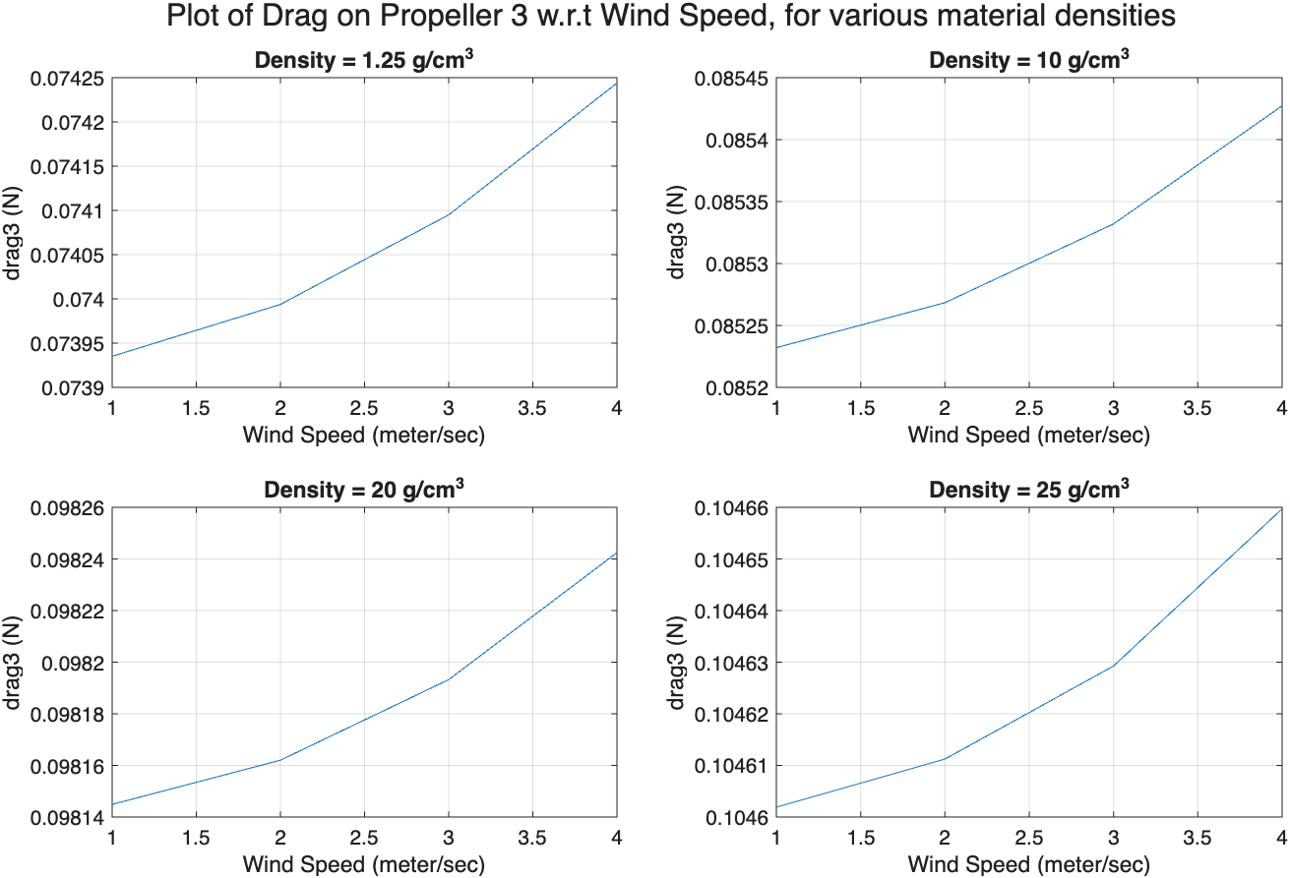
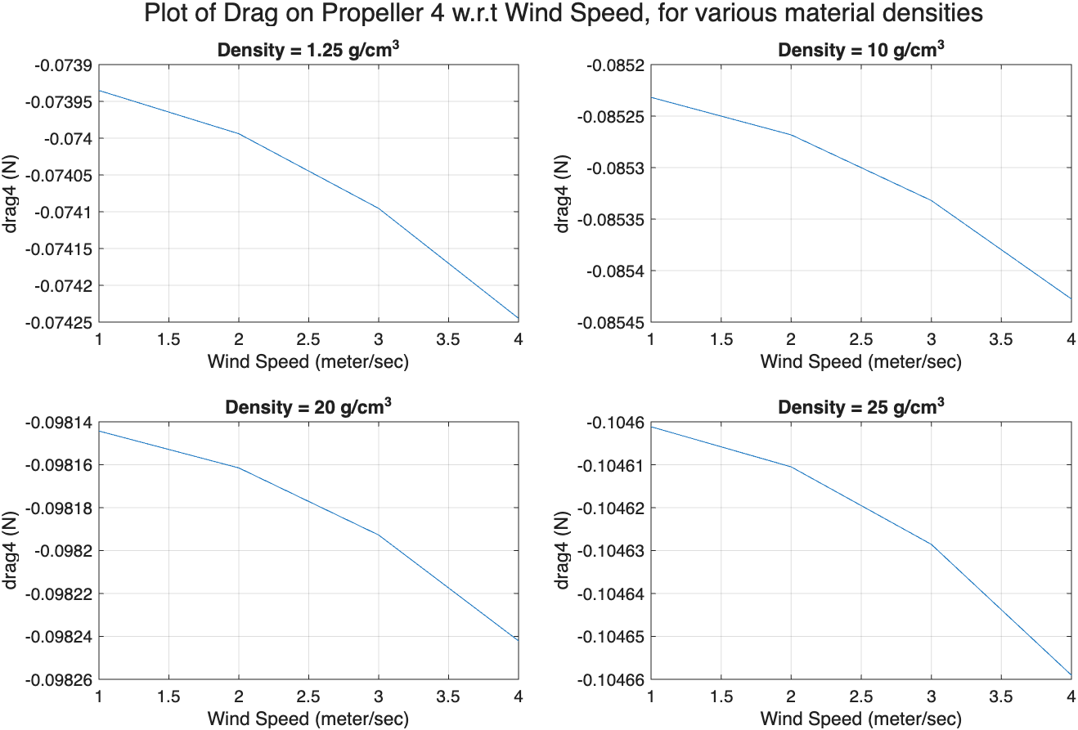
Sensitivity of Aerodynamic Drag on Propeller 3 and Propeller 4 to Material Density
The absolute value of drag force on blades of propeller 3 and 4 increases with an increase in wind velocity.
Also, the absolute drag of propeller 3 and 4 increases, with an increase in material density.

Slide 9
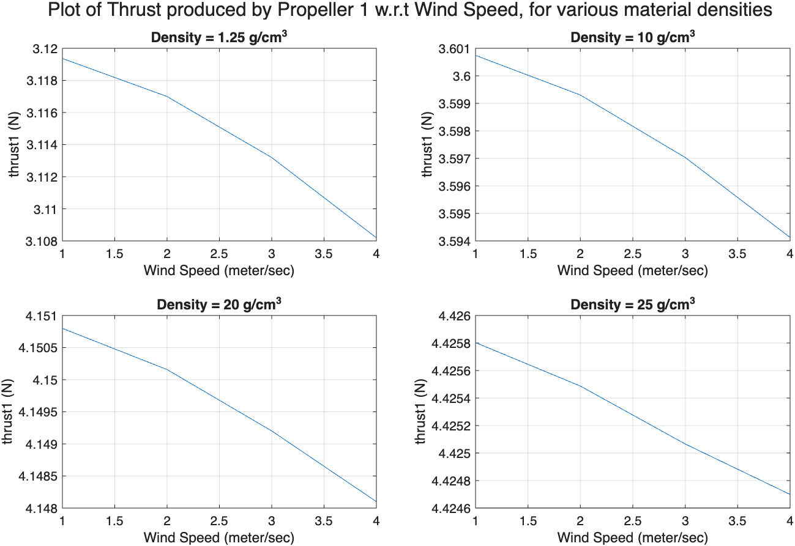
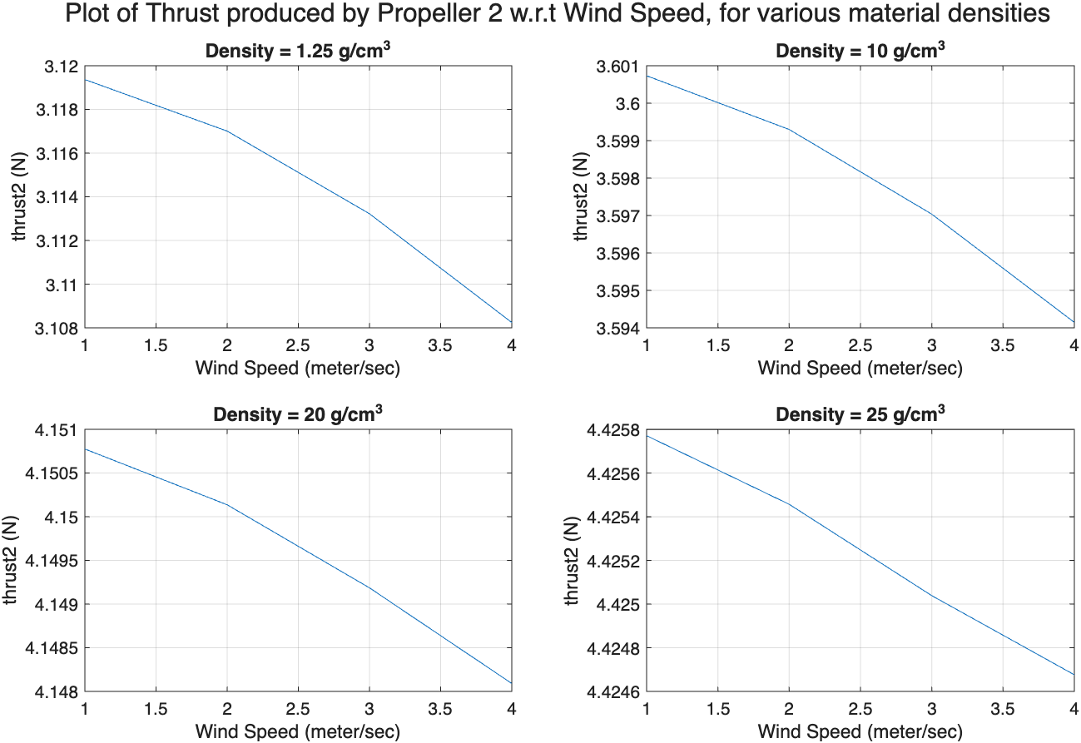
Sensitivity of thrust produced by Propeller 1 and Propeller 2 to Material Density
The thrust force produced by propeller 1 and 2 decreases with an increase in wind velocity.
However, the thrust force required from propeller 1 and 2 increases, with an increase in material density.

Slide 10
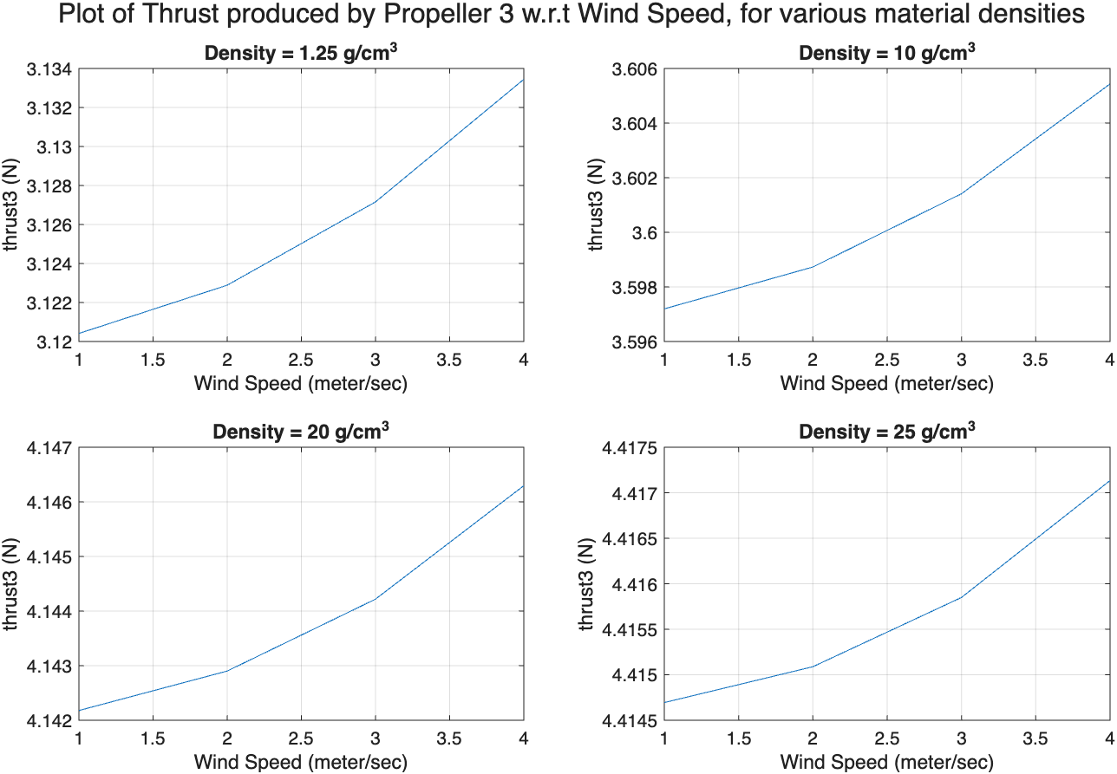
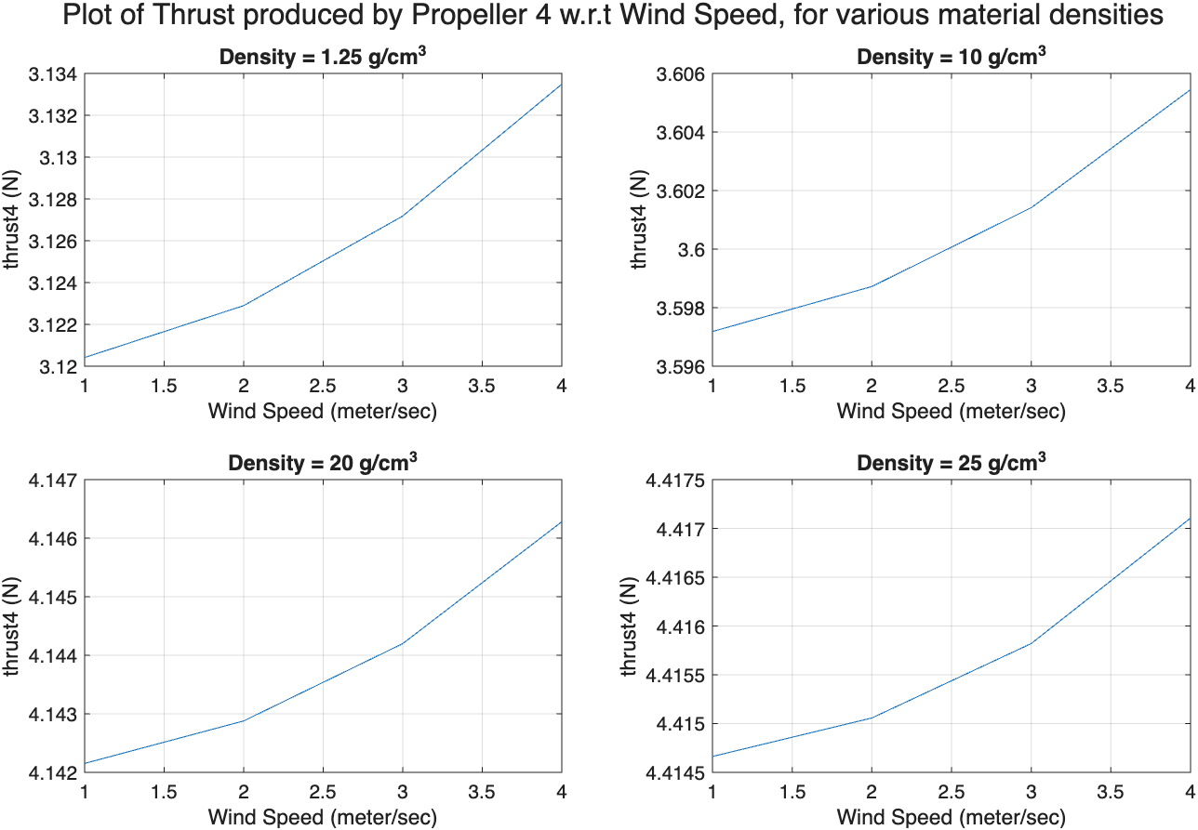
Sensitivity of Thrust produced by Propeller 1 and Propeller 2 to Material Density
The thrust force produced by propeller 3 and 4 increases with an increase in wind velocity.
Also, the the thrust force required from propeller 3 and 4 increases, with an increase in material density.

Slide 11
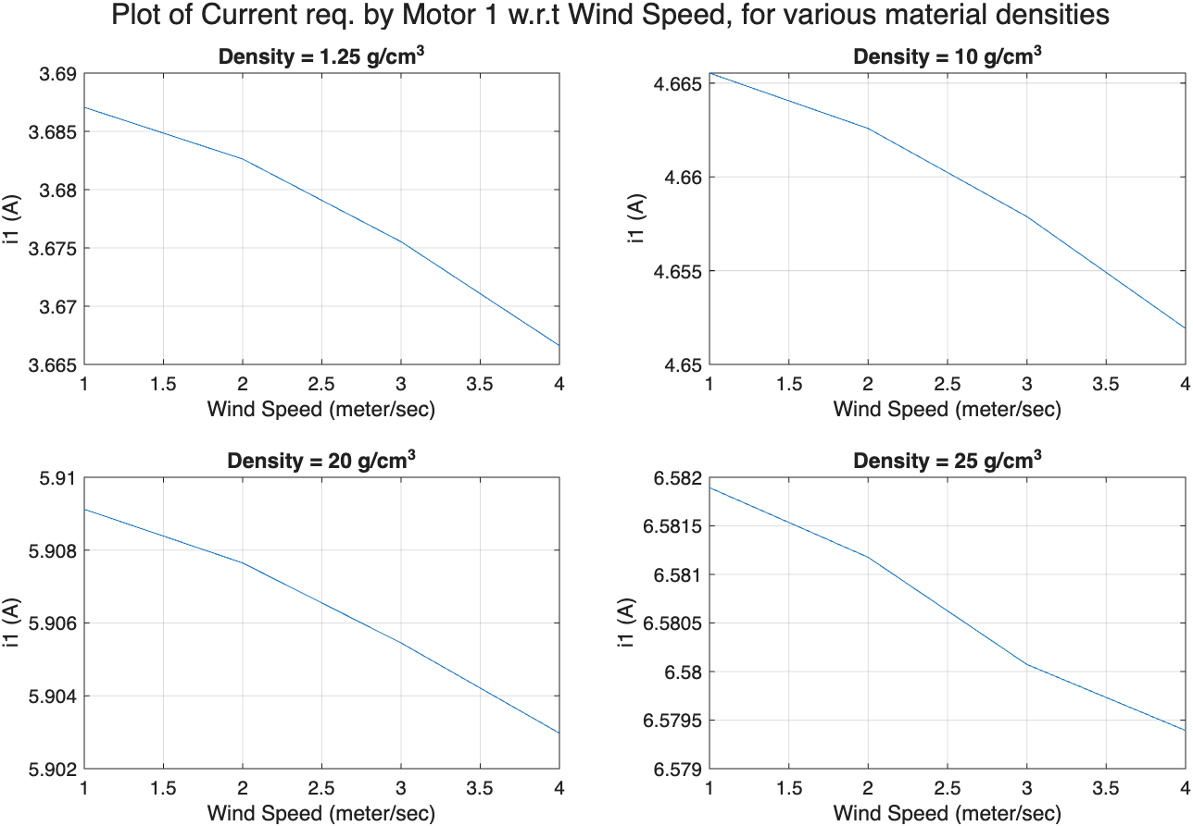
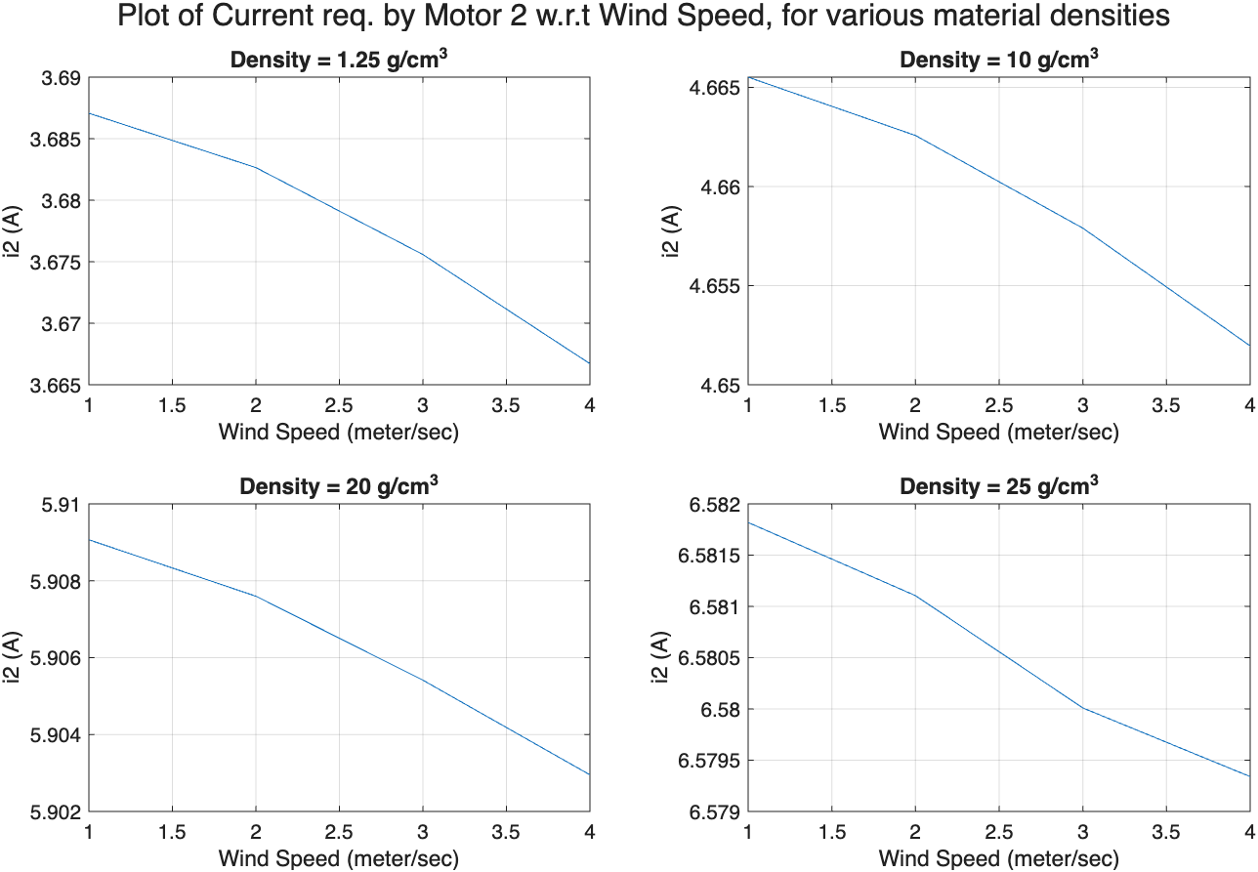
Sensitivity of Current required by Motor 1 and Motor 2 to Material Density
The current required by motor 1 and motor 2, decreases with an increase in wind velocity.
However, the current required by motor 1 and motor 2 increases, with an increase in material density.

Slide 12
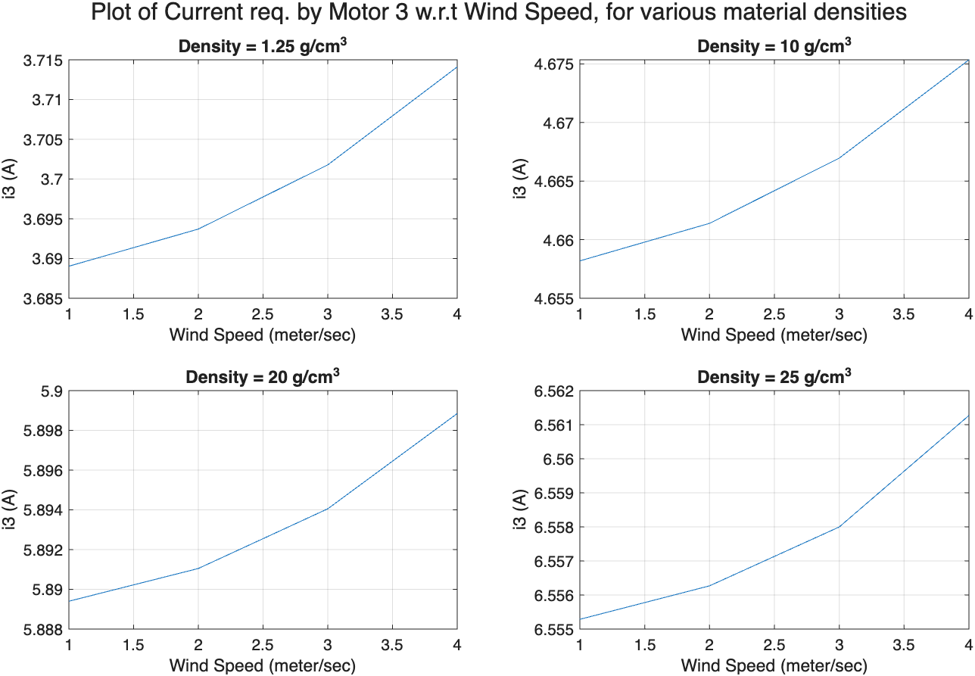
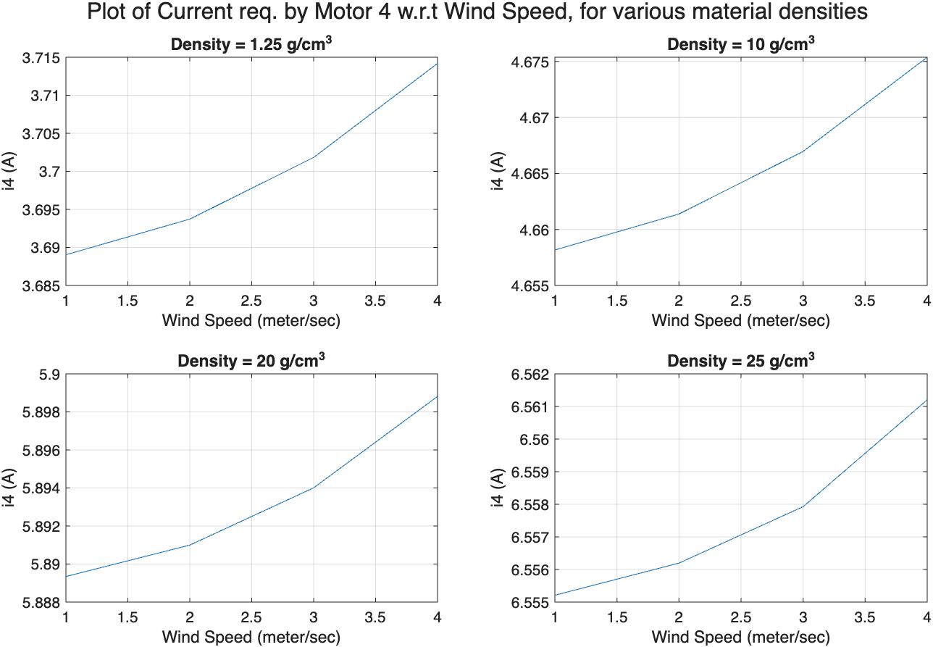
Sensitivity of Current required by Motor 1 and Motor 2 to Material Density
The current required by motor 1 and motor 2, increases with an increase in wind velocity.
Also, the current required by motor 1 and motor 2 increases, with an increase in material density.

Slide 13
Variation in Propeller Diameter

Slide 14
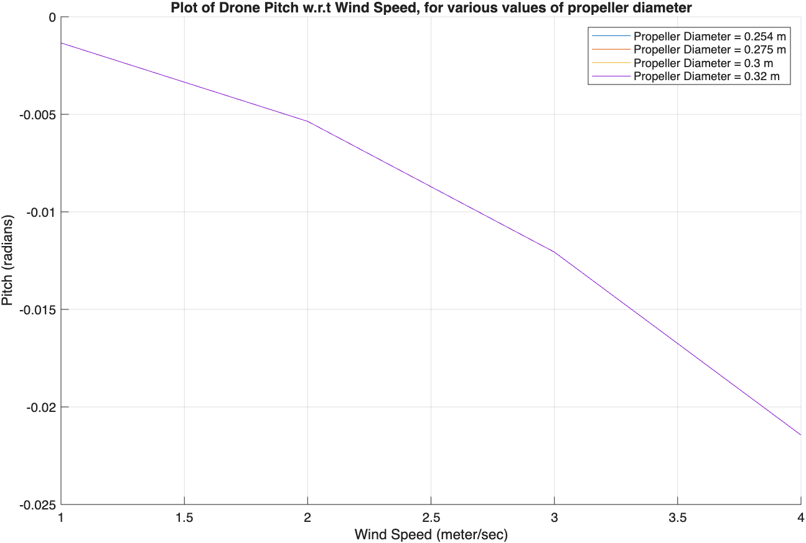
Sensitivity of Drone Pitch to Propeller Diameter
The absolute pitch angle of the drone chassis increases with an increase in the wind speed.
However, the pitch angle of the drone chassis is not affected by the size of the diameter of its propellers.

Slide 15
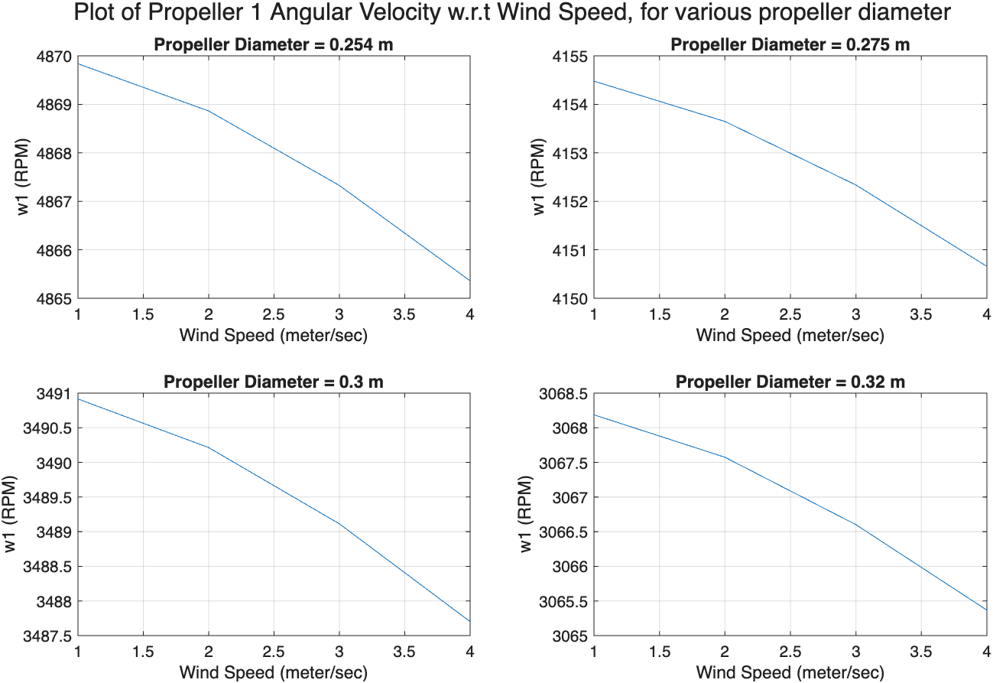
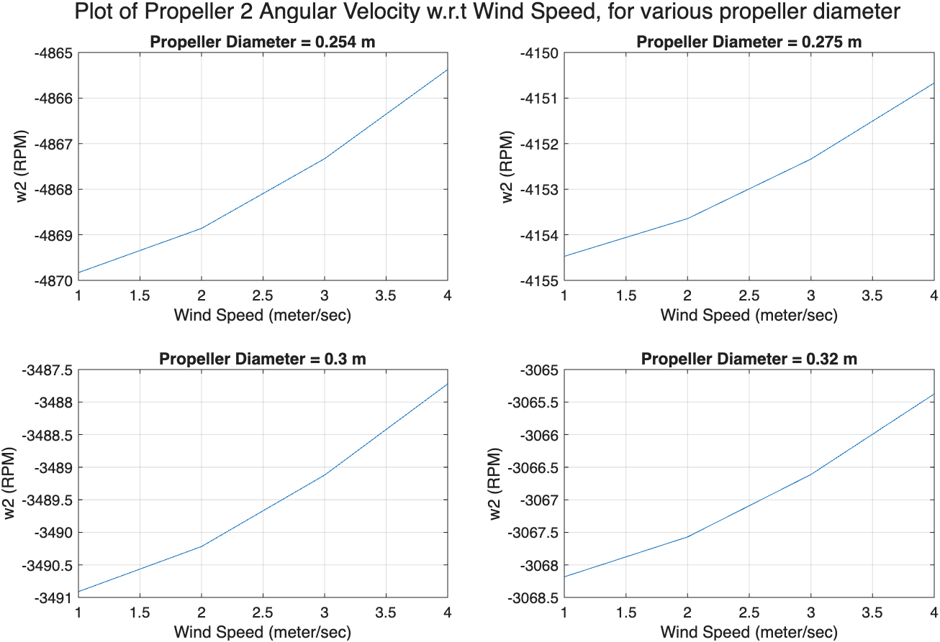
Sensitivity of Angular Velocity of Propeller 1 and 2 to the Propeller Diameter
The absolute angular velocity of propeller 1 and 2, decreases with an increase in wind velocity.
Also, the absolute angular velocity of propeller 1 and 2 decreases, with an increase in propeller diameter.

Slide 16
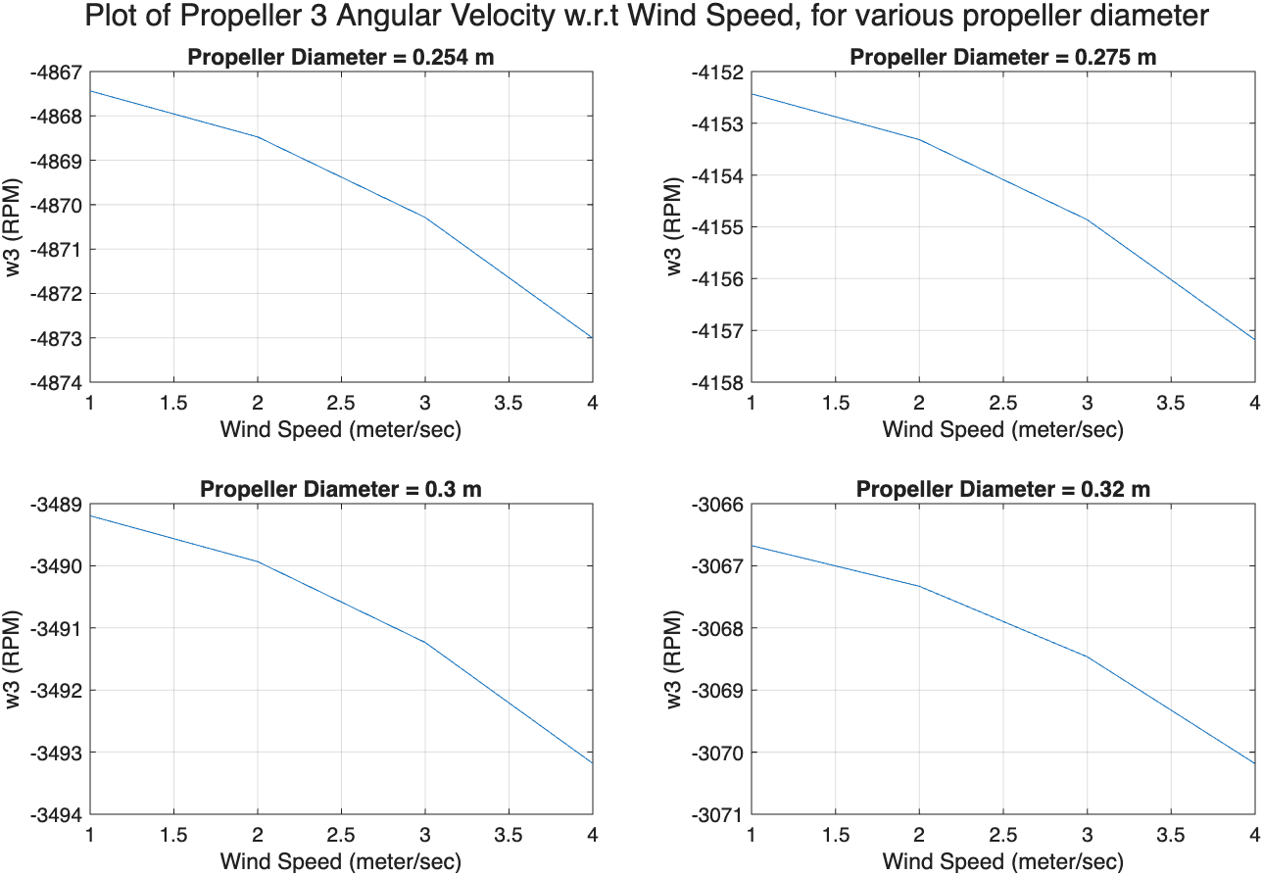
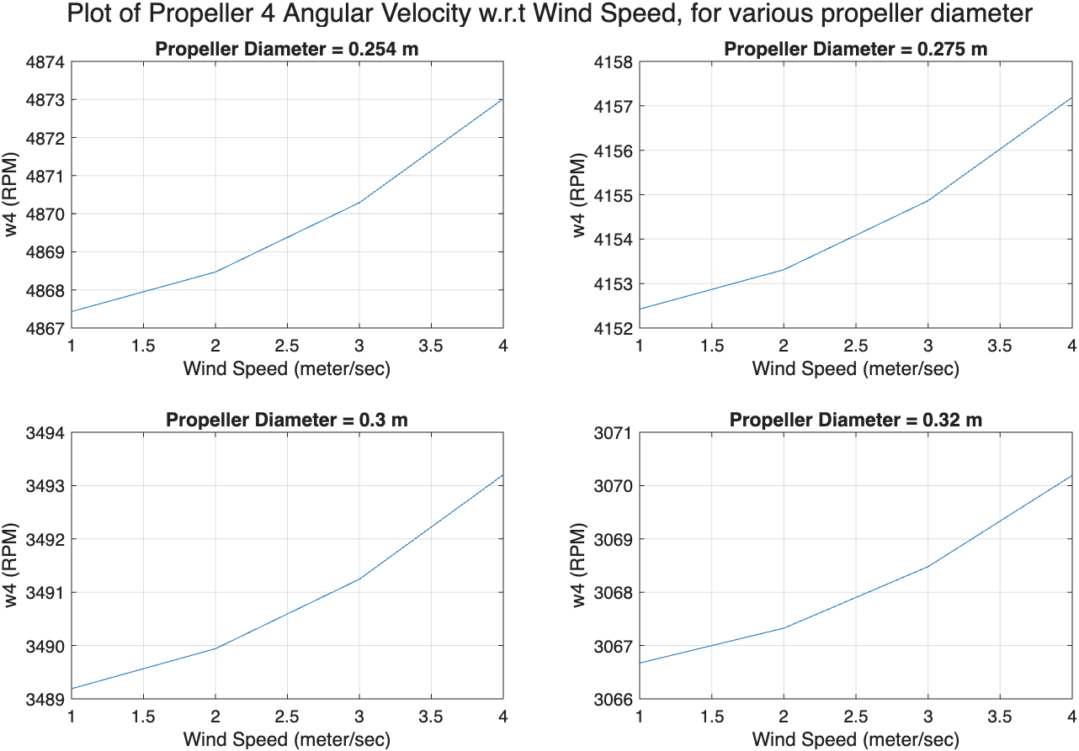
Sensitivity of Angular Velocity of Propeller 3 and 4 to the Propeller Diameter
The absolute angular velocity of propeller 3 and 4, increases with an increase in wind velocity.
However, the absolute angular velocity of propeller 3 and 4 decreases, with an increase in propeller diameter.

Slide 17
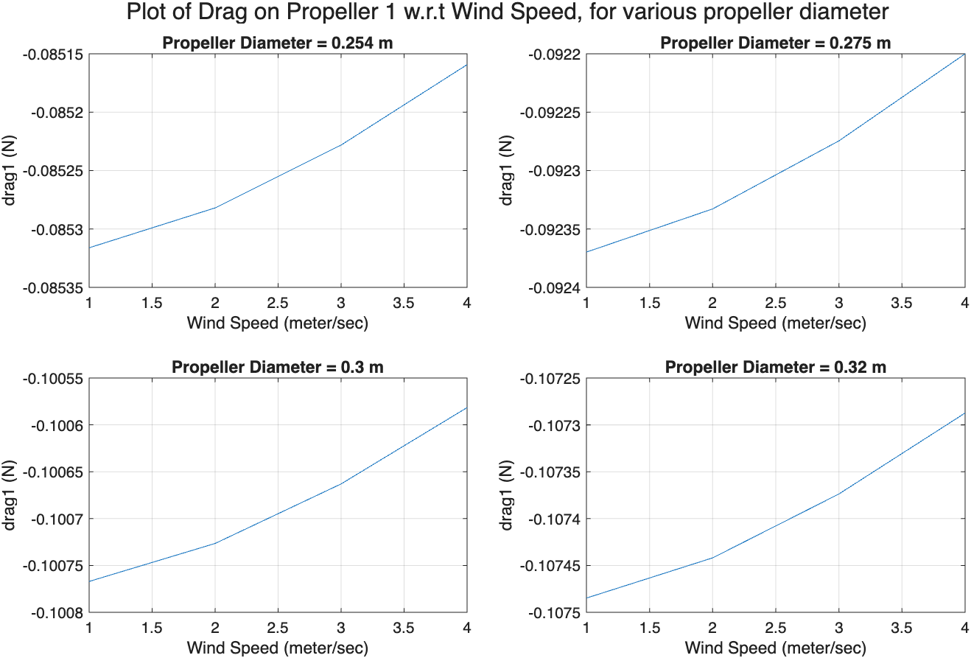
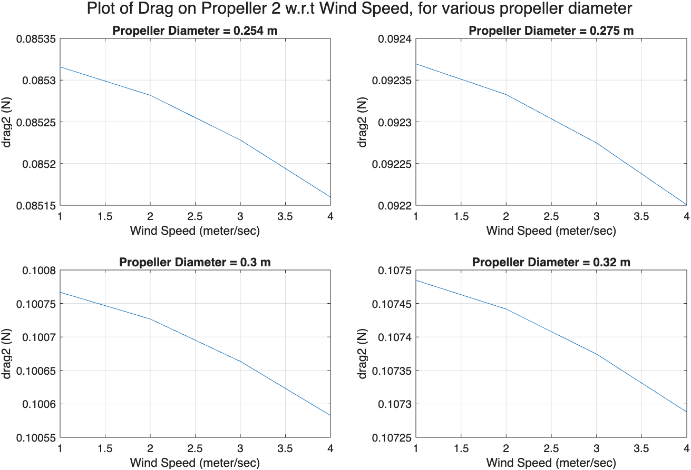
Sensitivity of Drag force on Propeller 1 and 2 to the Propeller Diameter
The absolute drag force on propeller 1 and 2, decreases with an increase in wind velocity.
However, the absolute drag force propeller 1 and 2 increases, with an increase in propeller diameter.

Slide 18
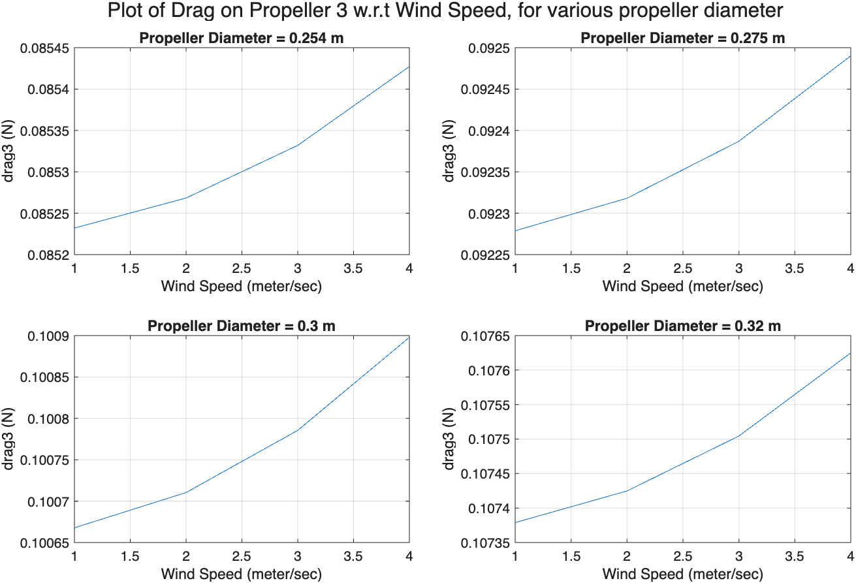
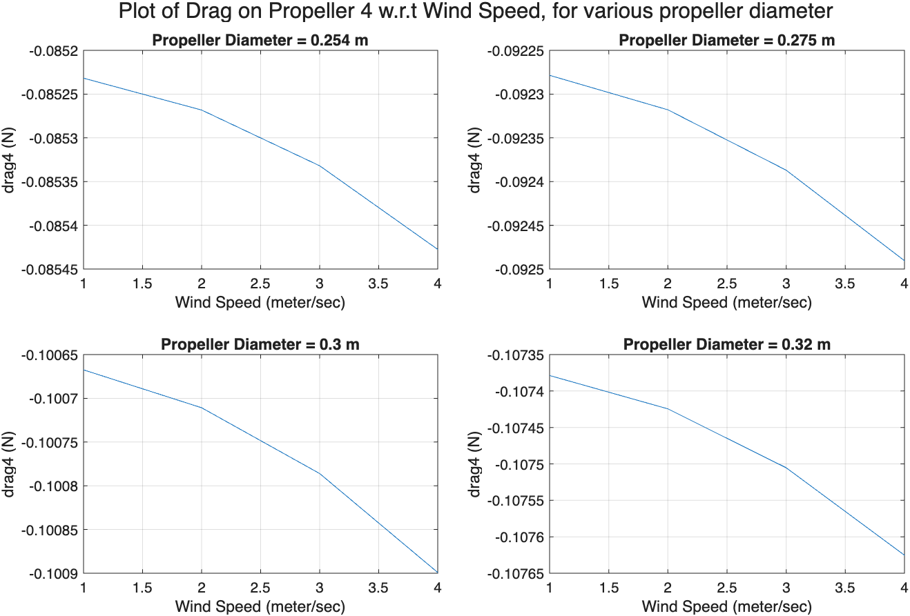
Sensitivity of Drag force on Propeller 3 and 4 to the Propeller Diameter
The absolute drag force on propeller 3 and 4, increases with an increase in wind velocity.
Also, the absolute drag force on propeller 3 and 4 increases, with an increase in propeller diameter.

Slide 19
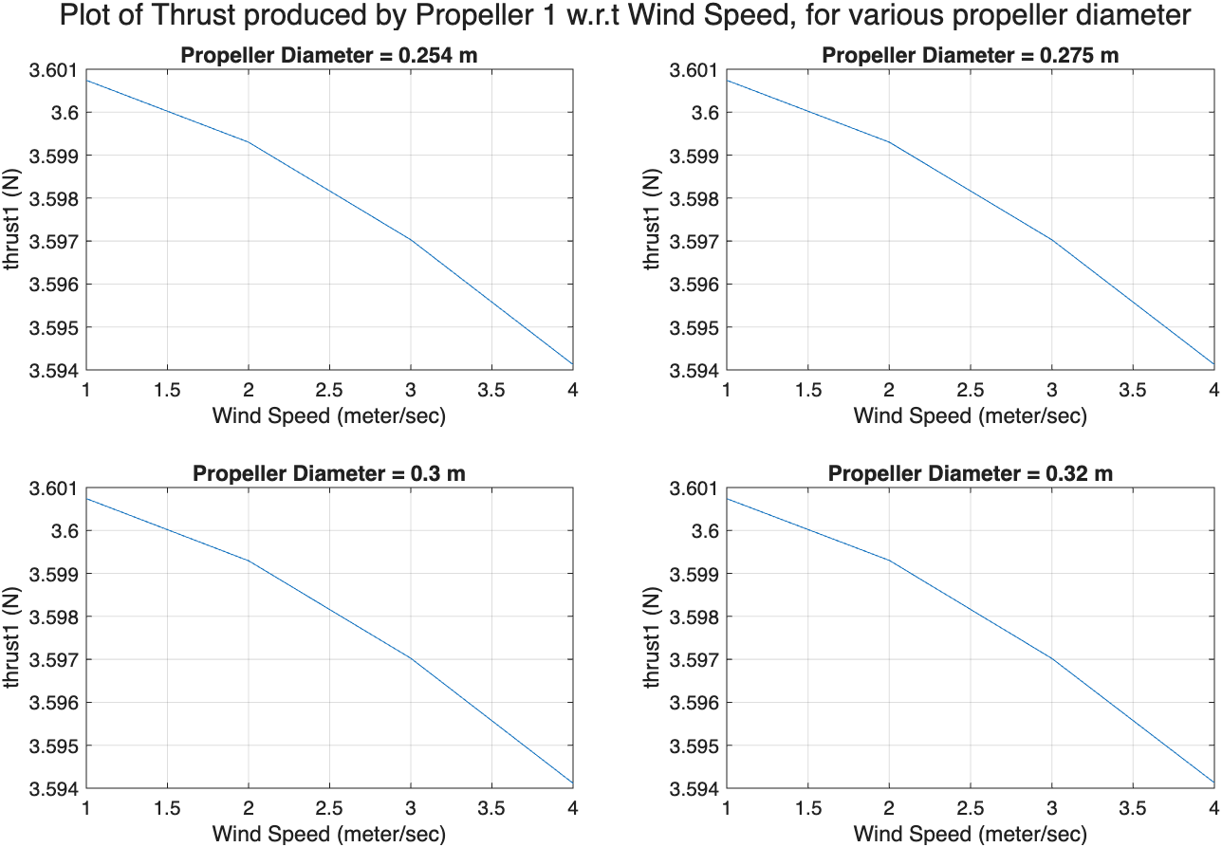
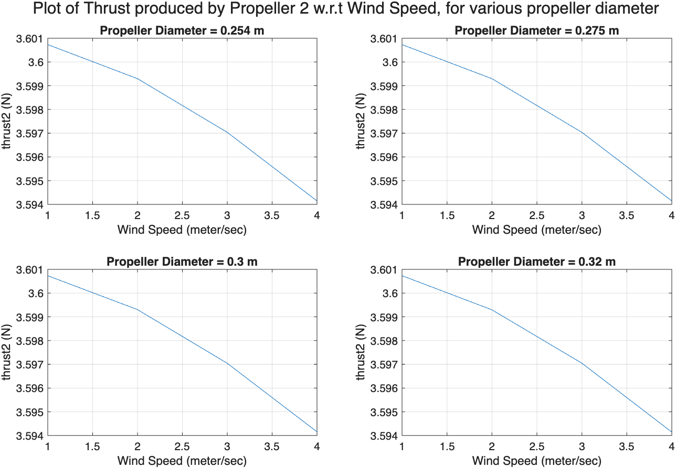
Sensitivity Thrust force produced by Propeller 1 and 2 to the Propeller Diameter
The thrust produced by propeller 1 and 2, decreases with an increase in wind velocity.
The thrust required from propeller 1 and 2 remains unaffected by an increase in propeller diameter.

Slide 20
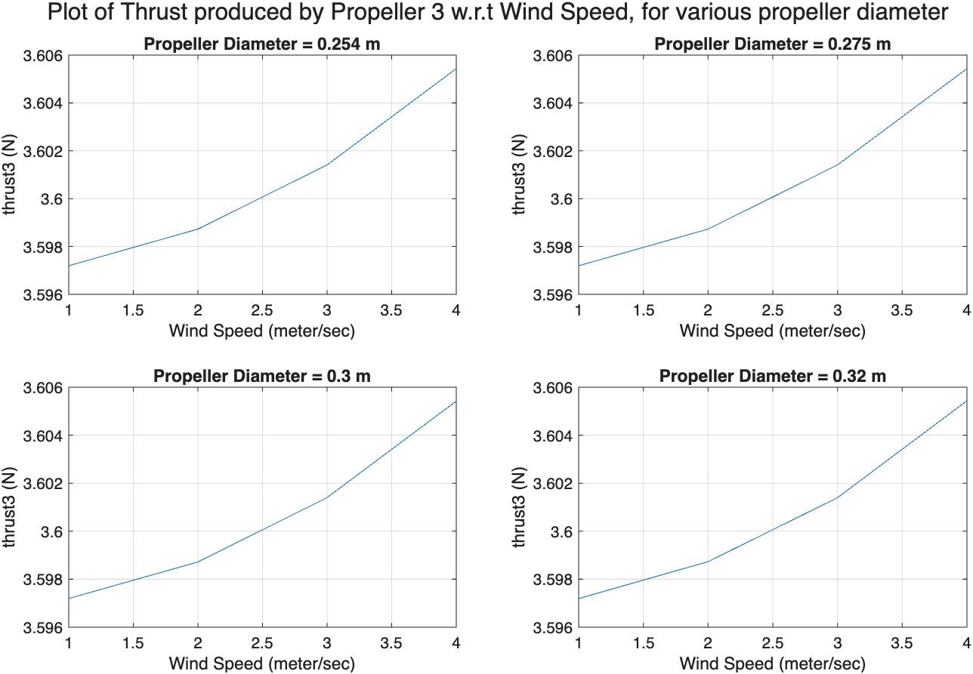
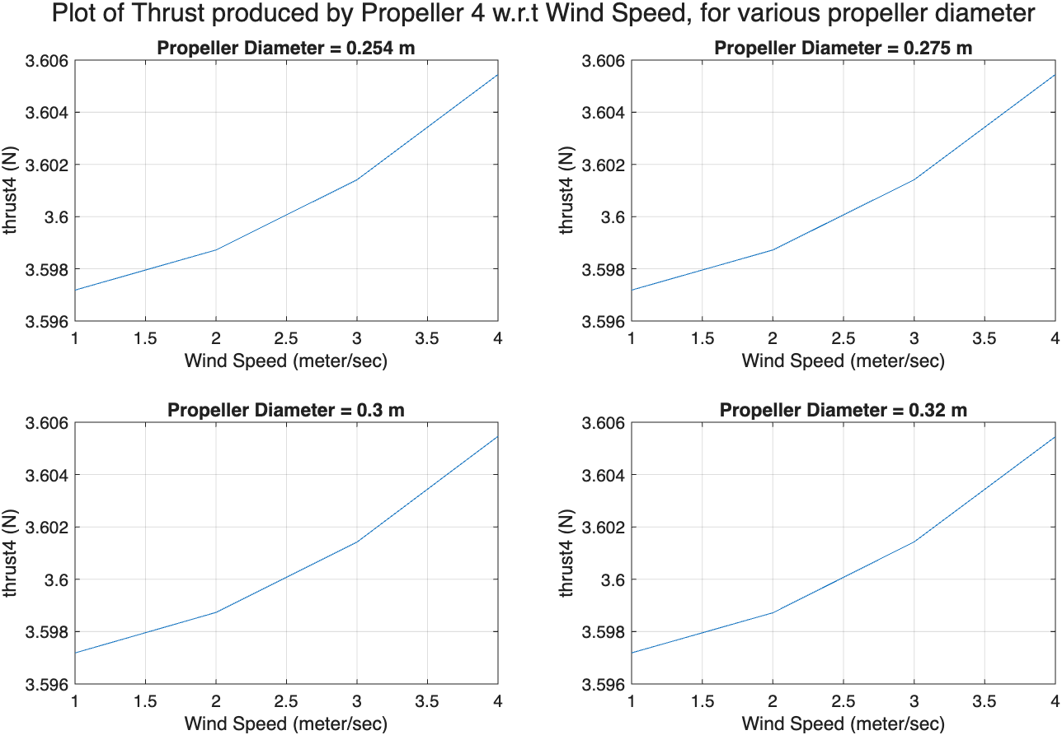
Sensitivity of Thrust force produced by Propeller 3 and 4 to the Propeller Diameter
The thrust produced by propeller 3 and 4, increases with an increase in wind velocity.
However, the thrust required from propeller 3 and 4 remains unaffected by an increase in propeller diameter.

Slide 21
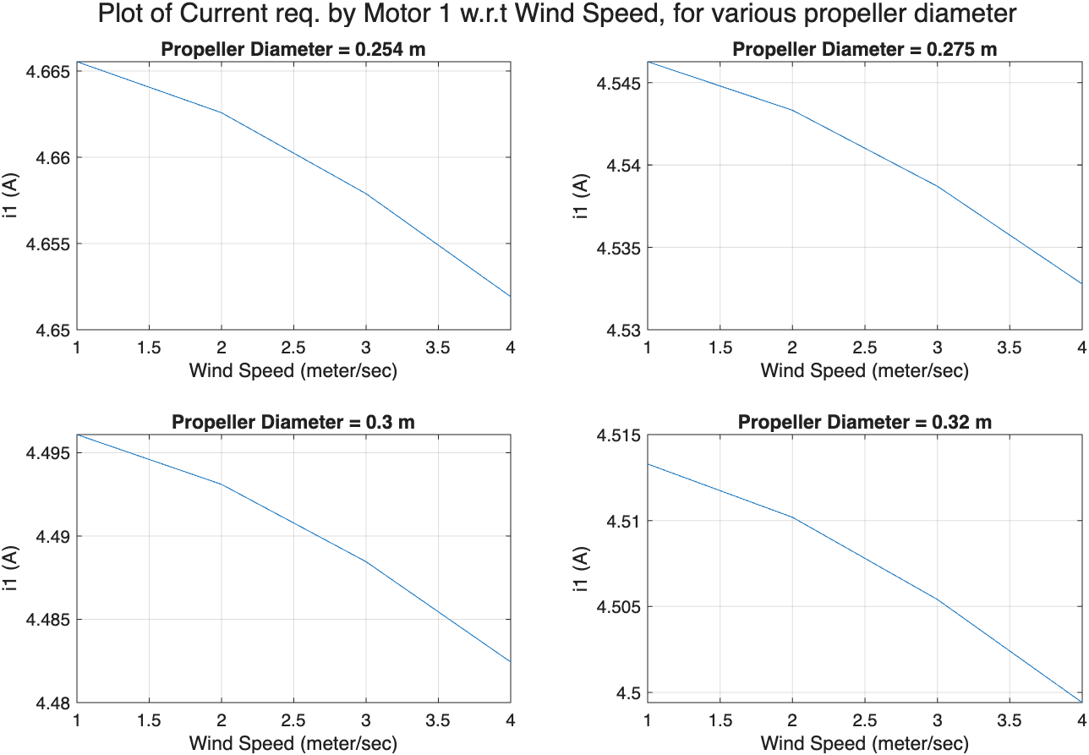
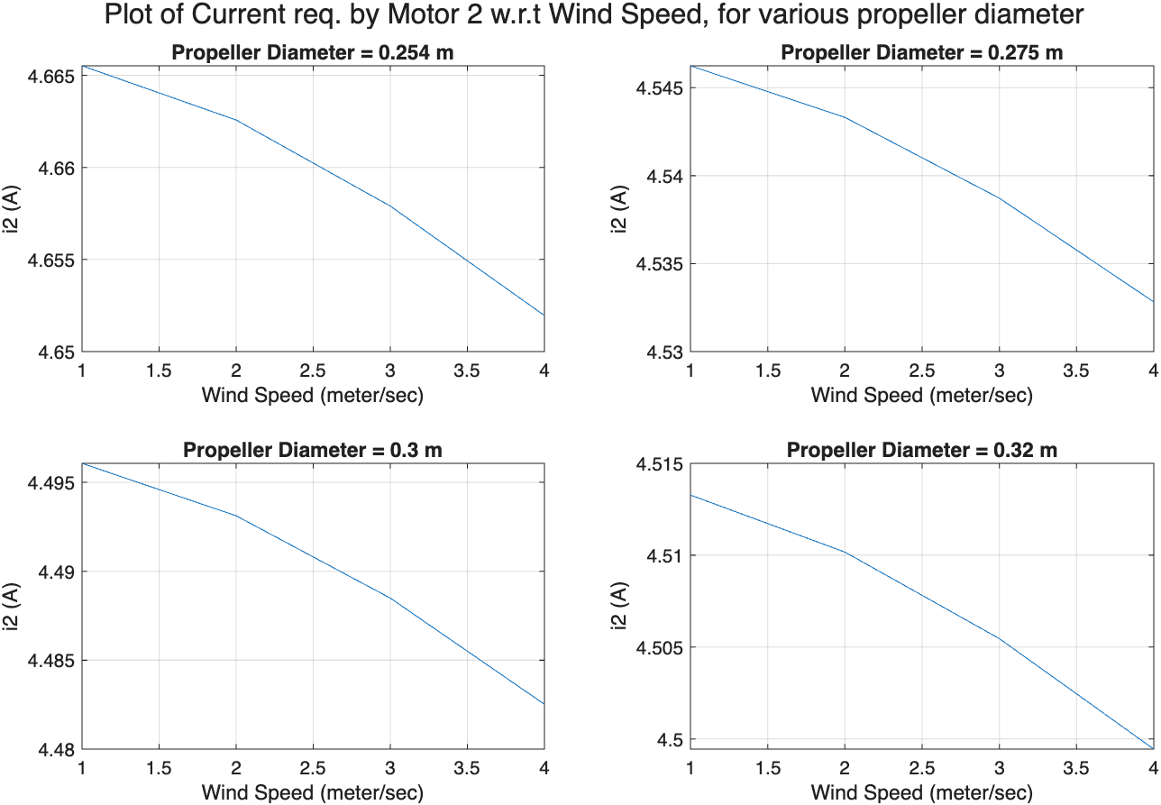
Sensitivity of the Current required by Motor 1 and 2 to the Propeller Diameter
The current required by motor 1 and 2, decreases with an increase in wind velocity.
However, the current required by motor 1 and 2 decreases, with an increase in propeller diameter.
(except for the change in diameter from 0.3 to 0.32)

Slide 22
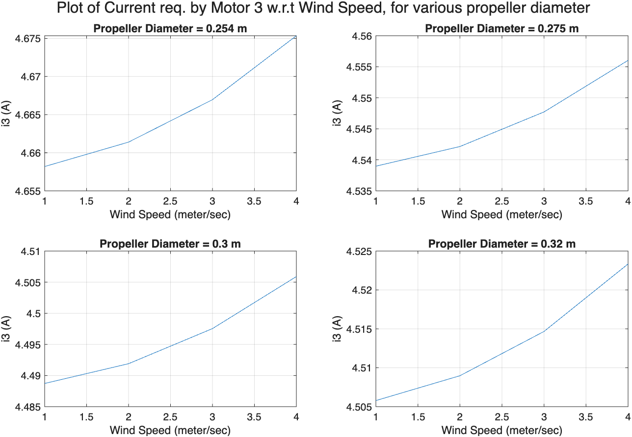

Sensitivity of the current required by Motor 3 and 4 to the Propeller Diameter
The current required by motor 3 and 4, increases with an increase in wind velocity.
Also, the current required by motor 1 and 2 decreases, with an increase in propeller diameter.
(except for the change in diameter from 0.3 to 0.32)

Slide 23
Variation in Propeller Thrust Constant

Slide 24
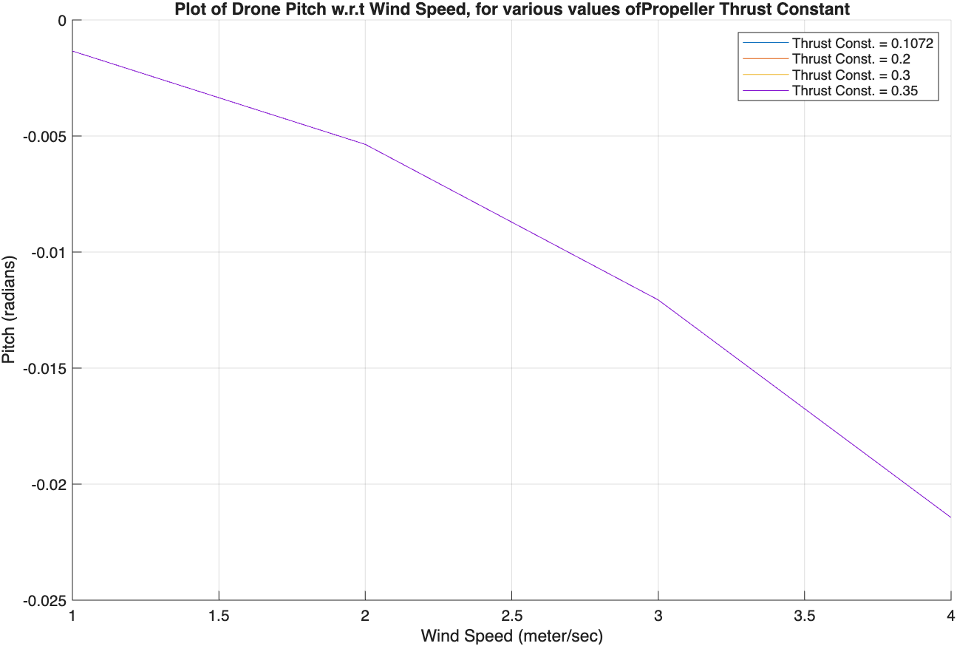
Sensitivity of Drone Pitch to Propeller Thrust Constant
The absolute pitch angle of drone increases with an increase in wind speed.
However, the pitch angle of drone remains unaffected by an increase in propeller thrust constant.

Slide 25
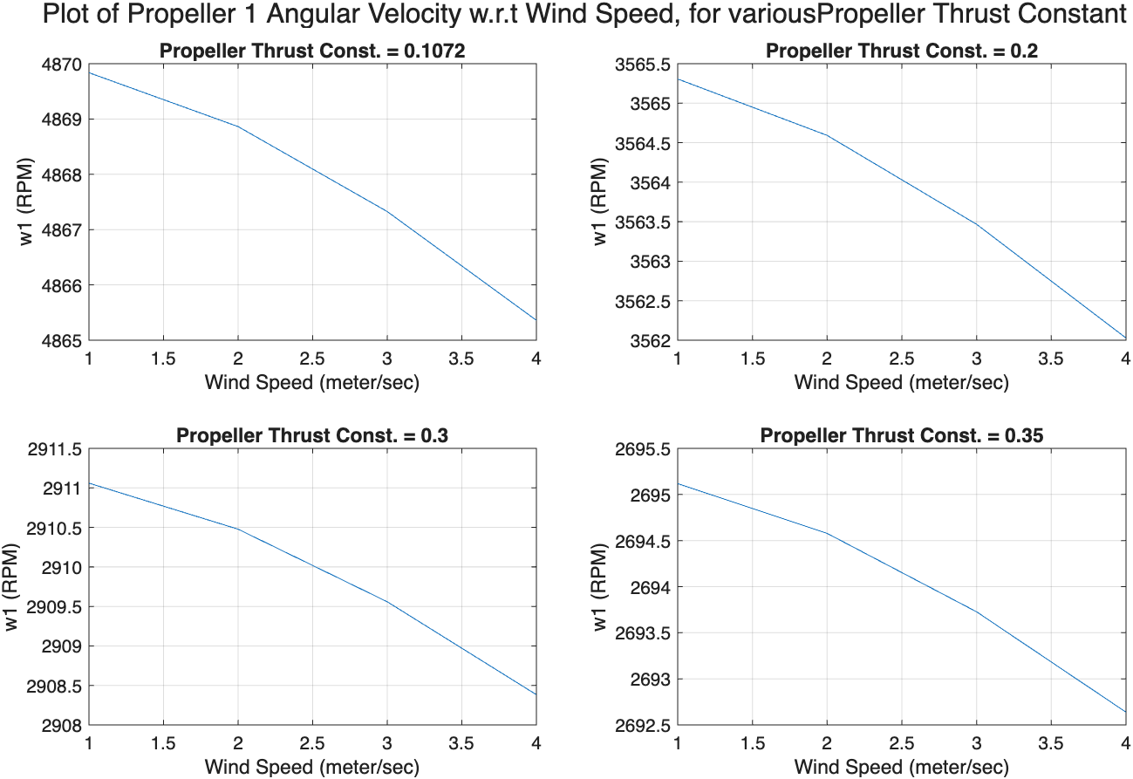
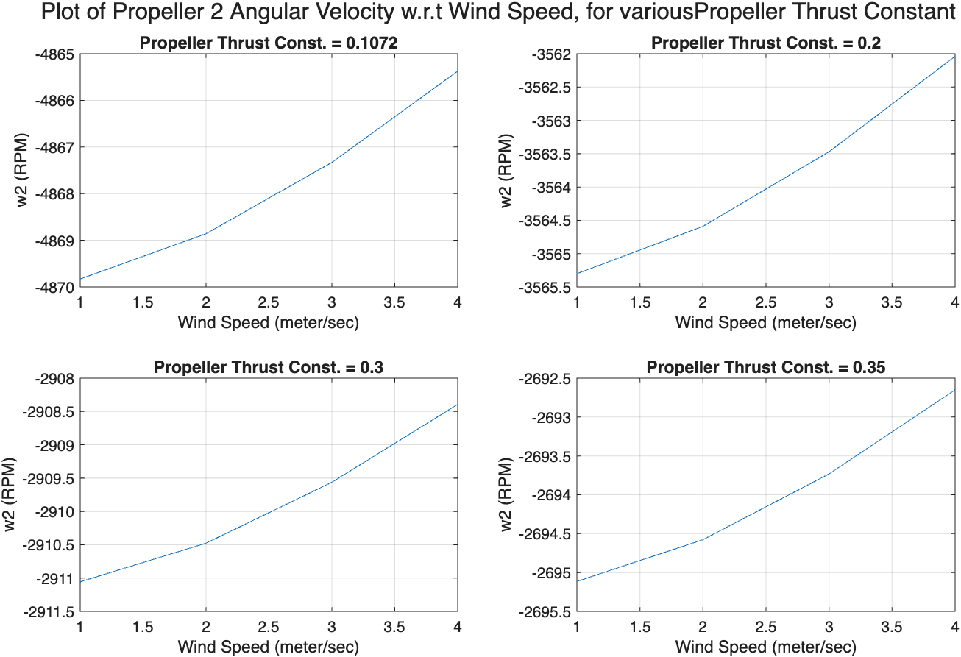
Sensitivity of Angular Velocity of Propeller 1 and 2 to Propeller Thrust Constant
The absolute angular velocity propeller 1 and 2, decreases with an increase in wind velocity.
Also, the absolute angular velocity of propeller 1 and 2, decreases with an increase in propeller thrust constant.

Slide 26
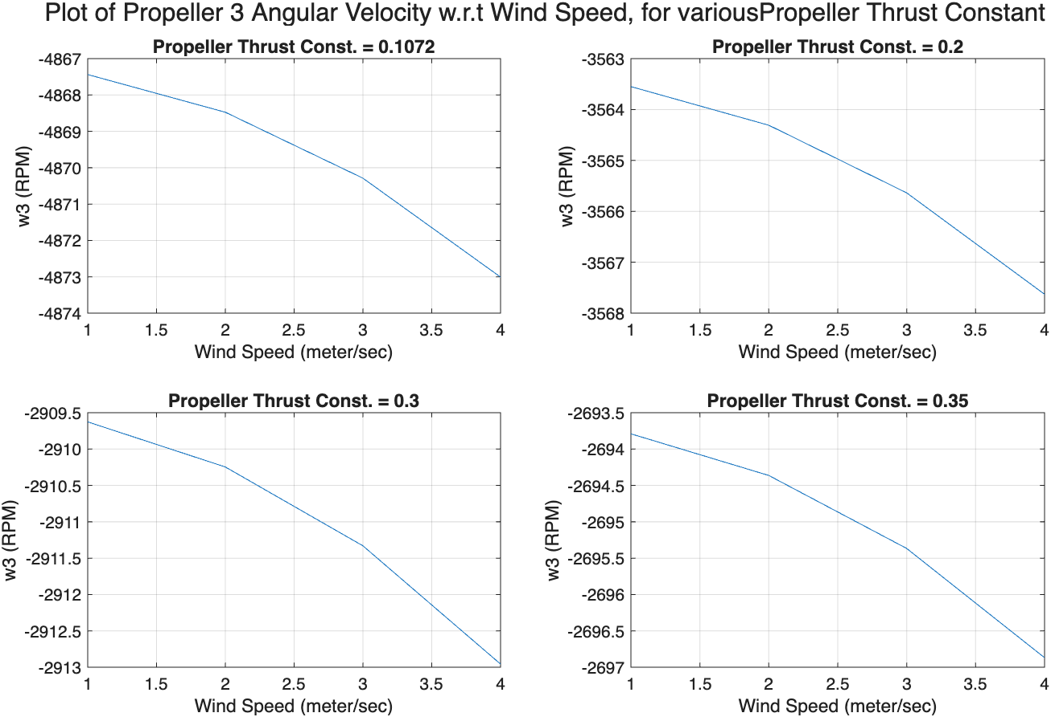
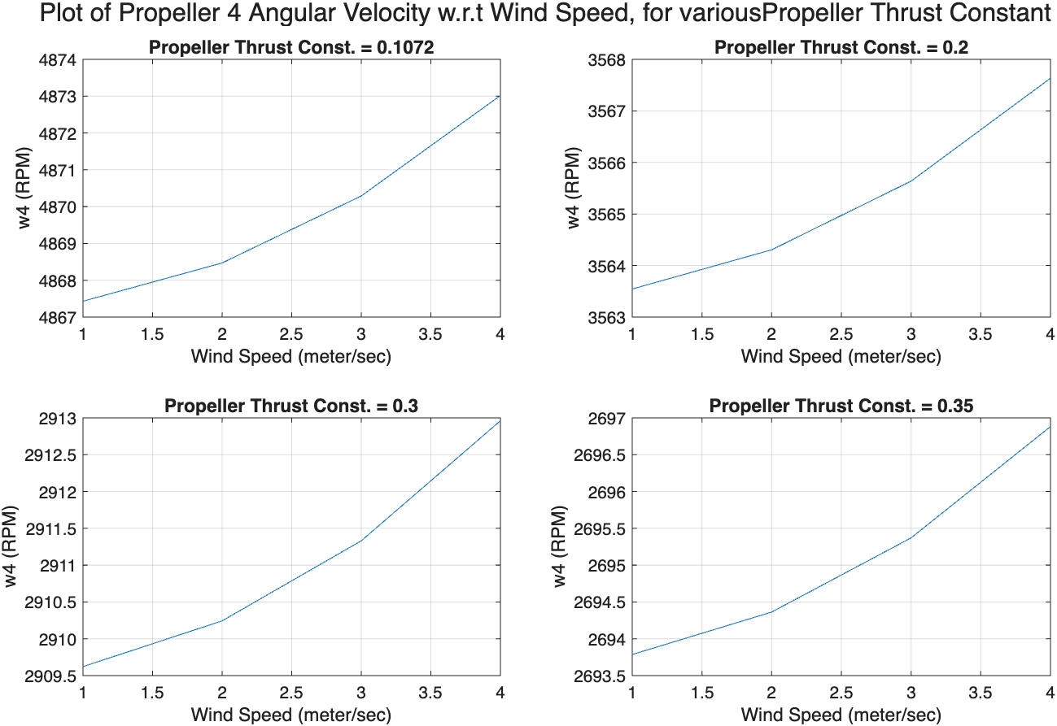
Sensitivity of Angular Velocity of Propeller 3 and 4 to Propeller Thrust Constant
The absolute angular velocity propeller 3 and 4, increases with an increase in wind velocity.
However, the absolute angular velocity of propeller 3 and 4, decreases with an increase in propeller thrust constant.

Slide 27
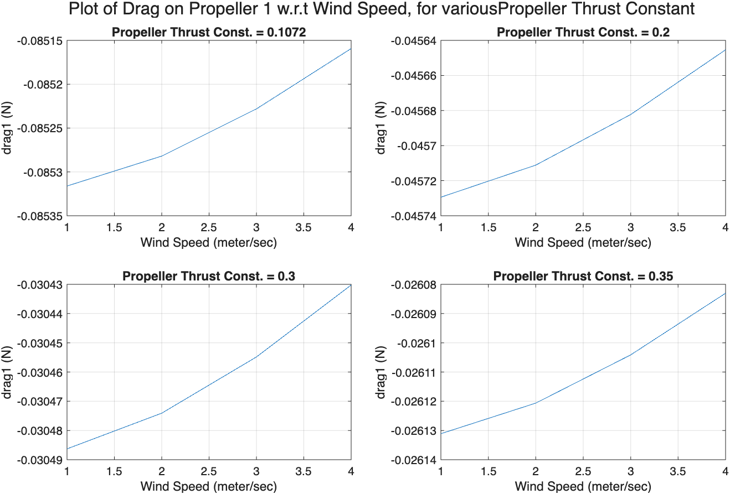
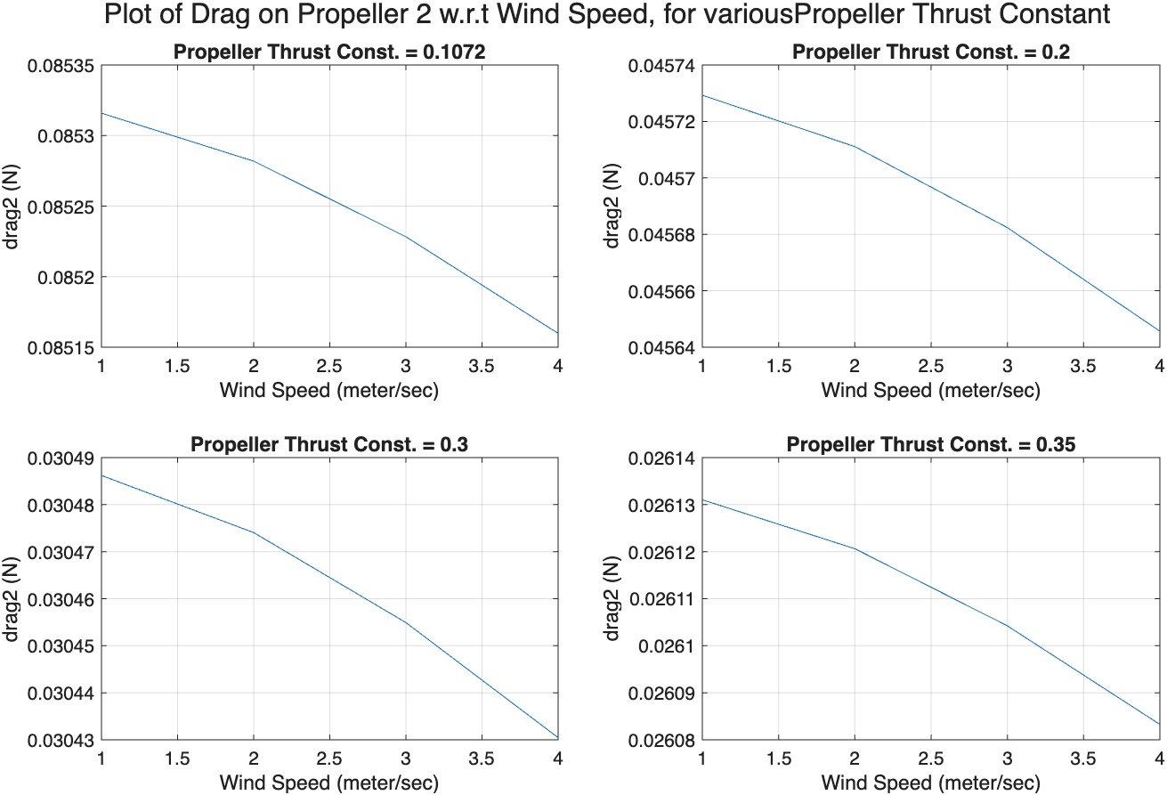
Sensitivity of Drag force on Propeller 1 and 2 to Propeller Thrust Constant
The absolute drag force on propeller 1 and 2, decreases with an increase in wind velocity.
The absolute drag force on propeller 1 and 2, also decreases with an increase in propeller thrust constant.

Slide 28
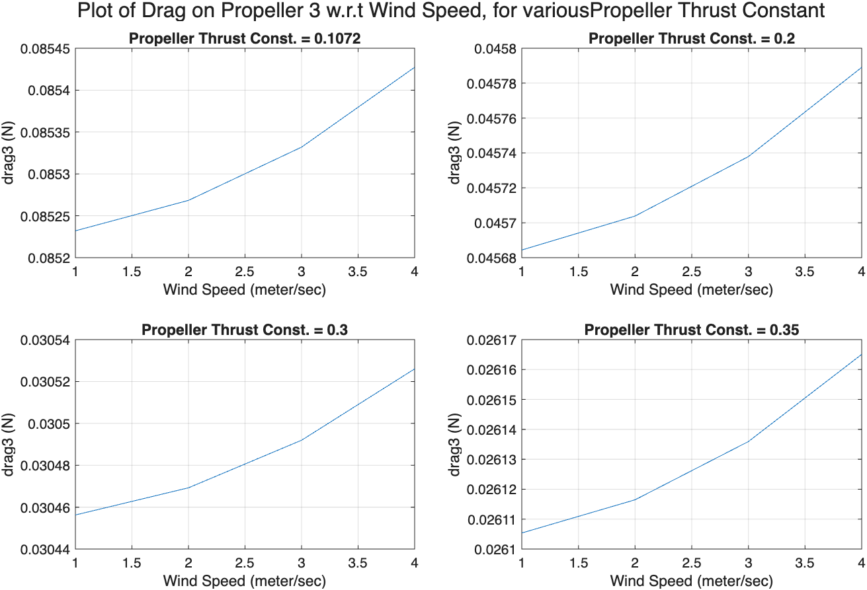
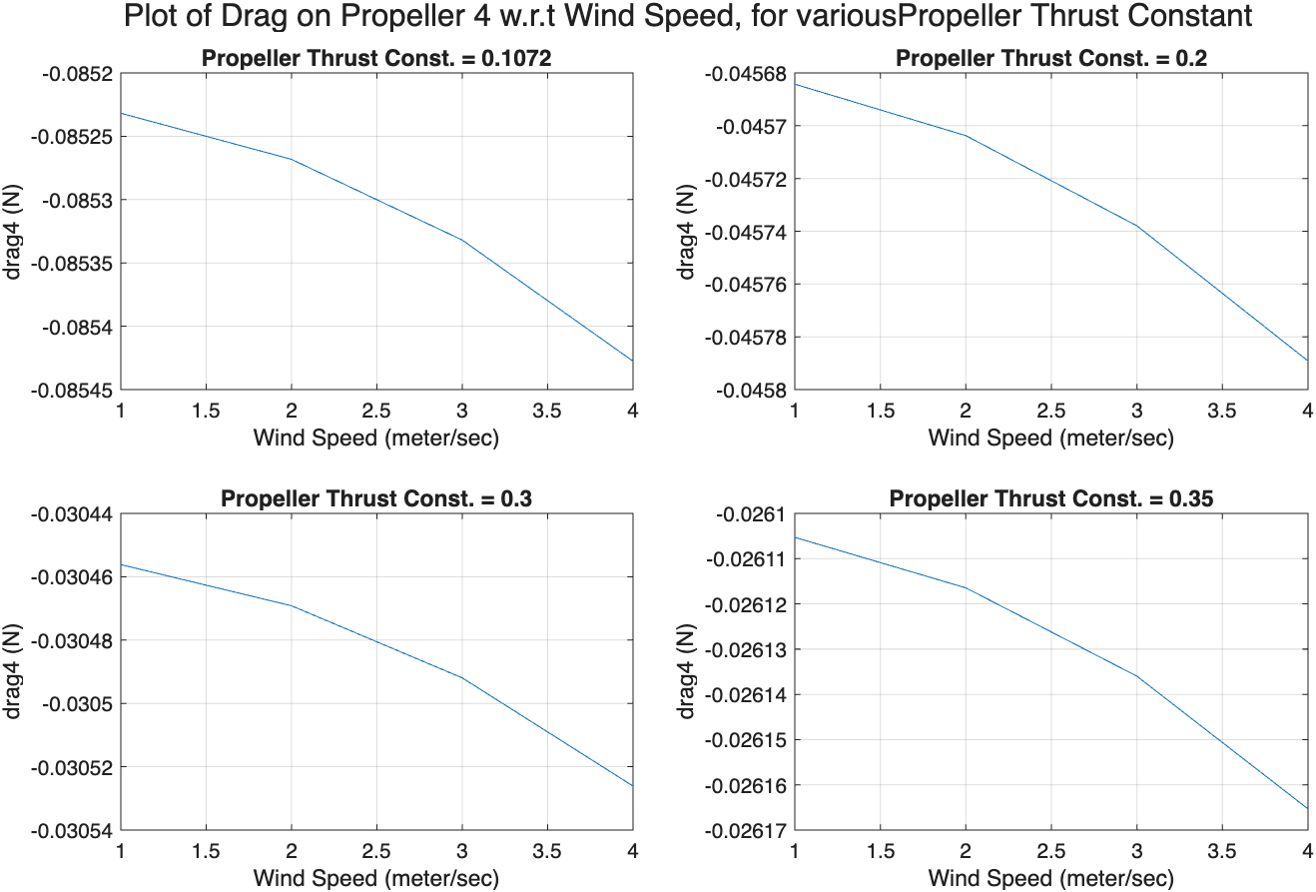
Sensitivity of Drag force on Propeller 3 and 4 to Propeller Thrust Constant
The absolute drag force on propeller 3 and 4, increases with an increase in wind velocity.
However, the absolute drag force on propeller 3 and 4, decreases with an increase in propeller thrust constant.

Slide 29
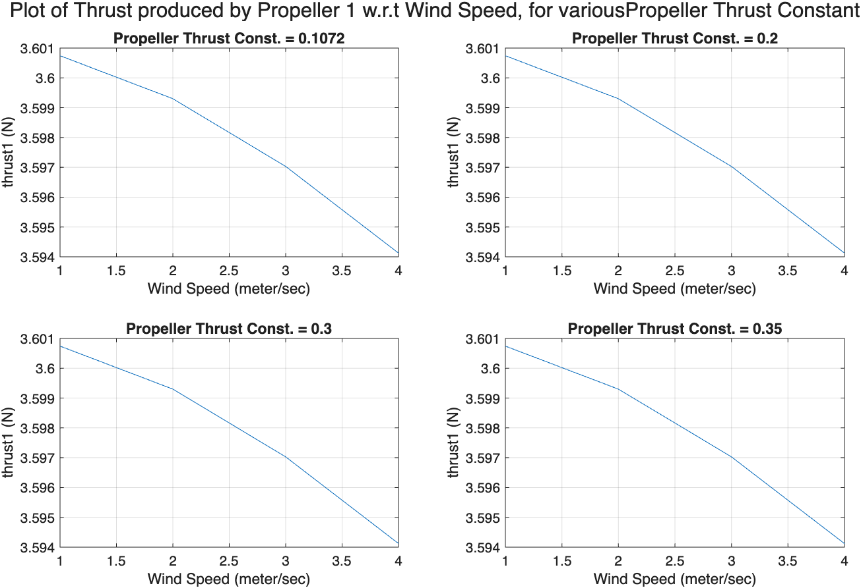
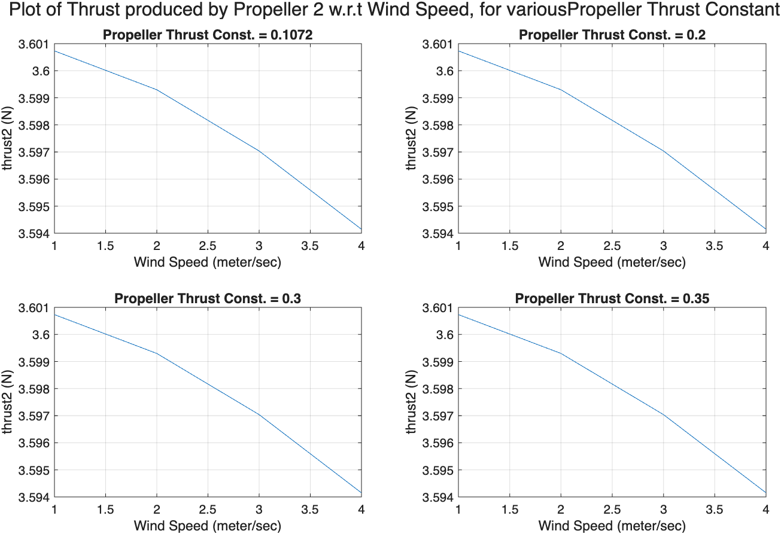
Sensitivity of Thrust produced by Propeller 1 and 2 to Propeller Thrust Constant
The thrust force produced by propeller 1 and 2, decreases with an increase in wind velocity.
However, the thrust force produced by propeller 1 and 2, remains unaffected by an increase in propeller thrust constant.

Slide 30
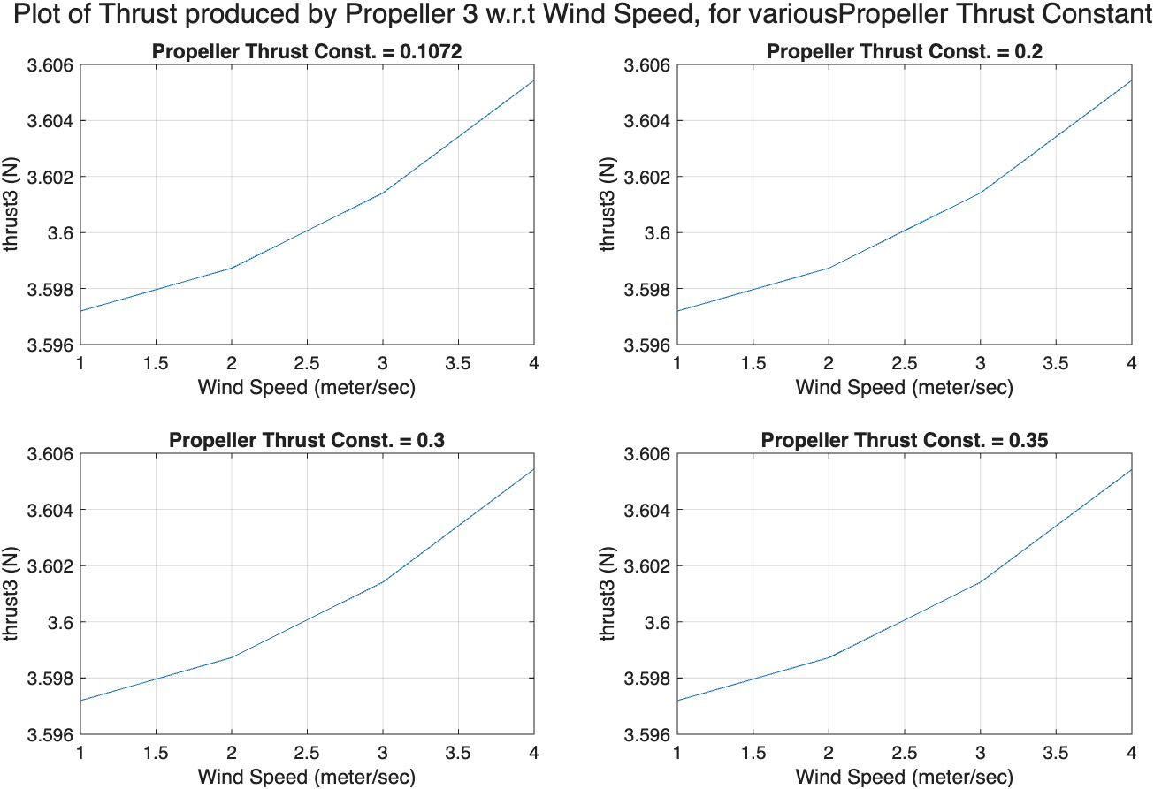
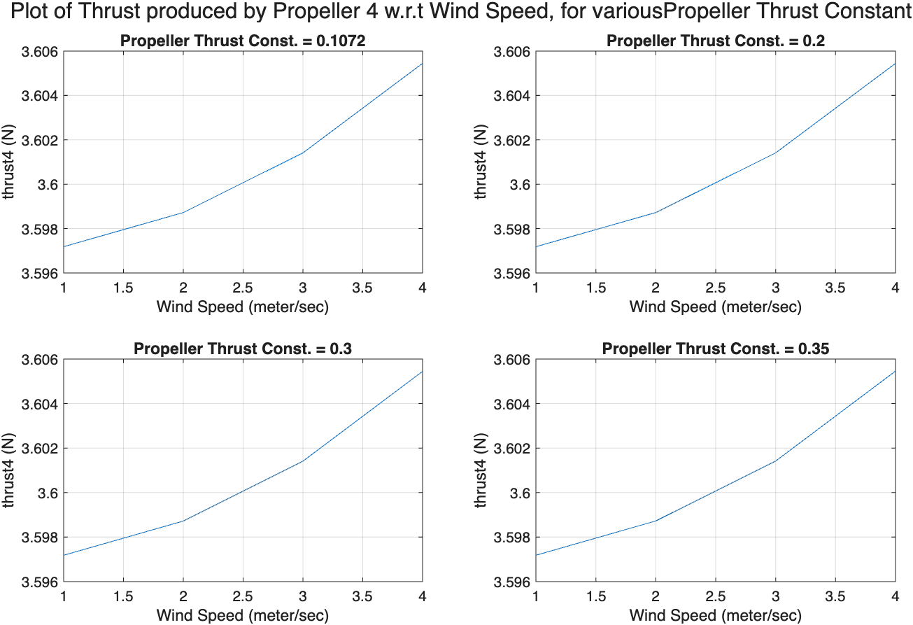
Sensitivity of Thrust produced by Propeller 3 and 4 to Propeller Thrust Constant
The thrust force produced by propeller 3 and 4, increases with an increase in wind velocity.
Also, the thrust force produced by propeller 3 and 4, remains unaffected by an increase in propeller thrust constant.

Slide 31
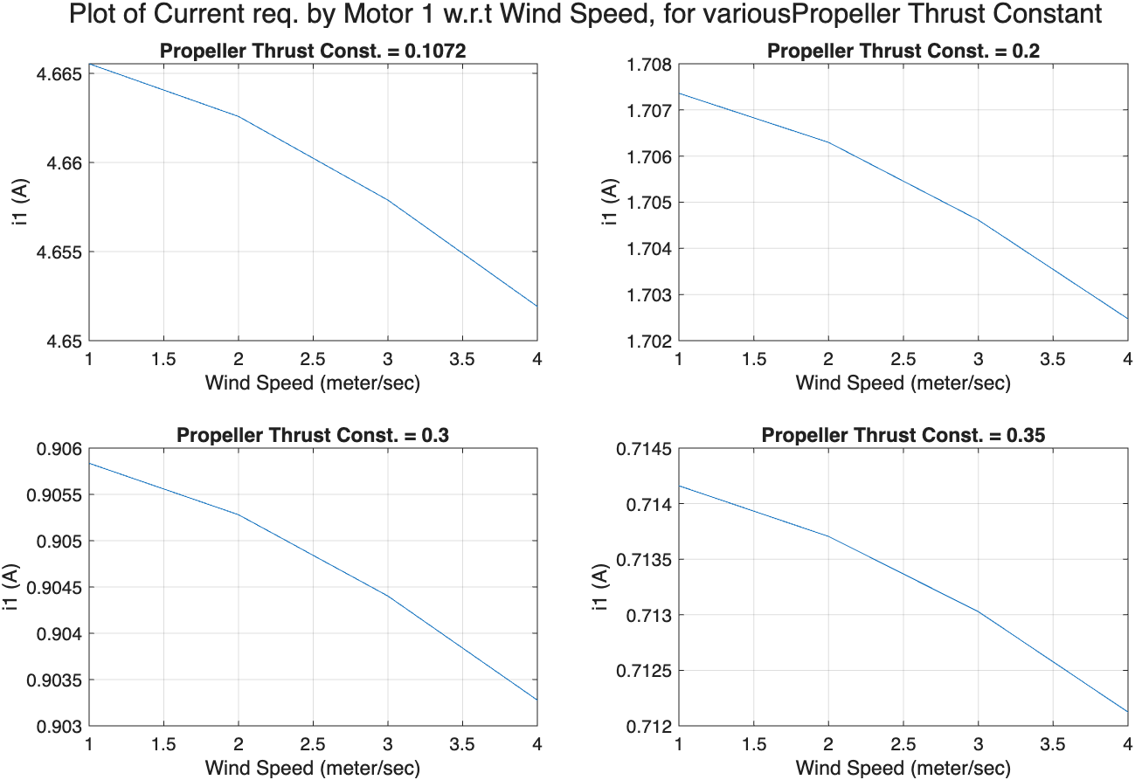
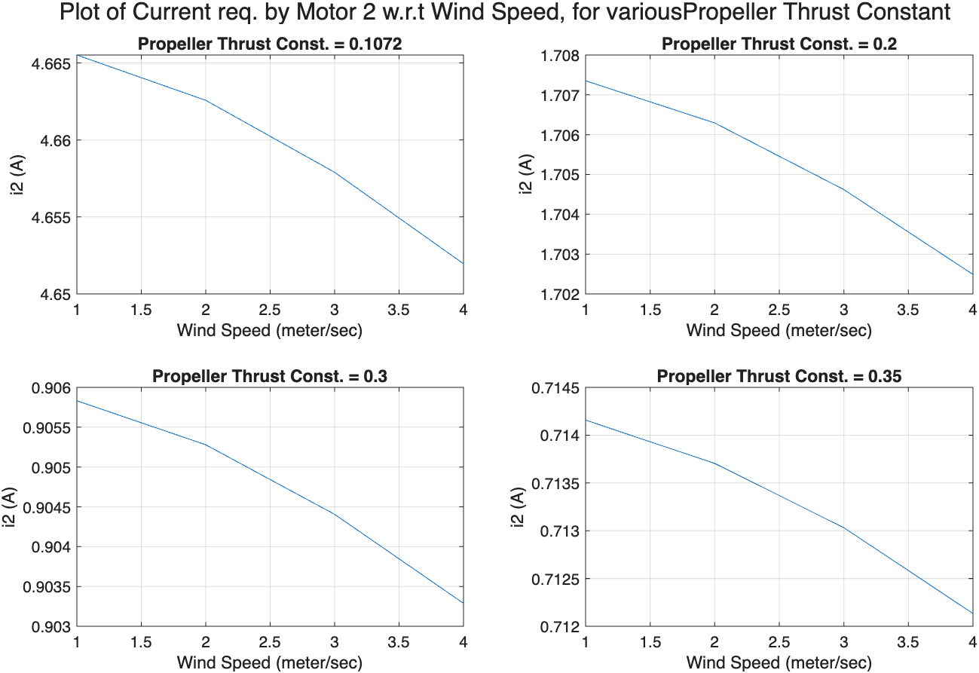
Sensitivity of Current required by Motor 1 and 2 to Propeller Thrust Constant
The current required by motor 1 and 2, decreases with an increase in wind velocity.
Also, the current required by motor 1 and 2, decreases with an increase in propeller thrust constant.

Slide 32
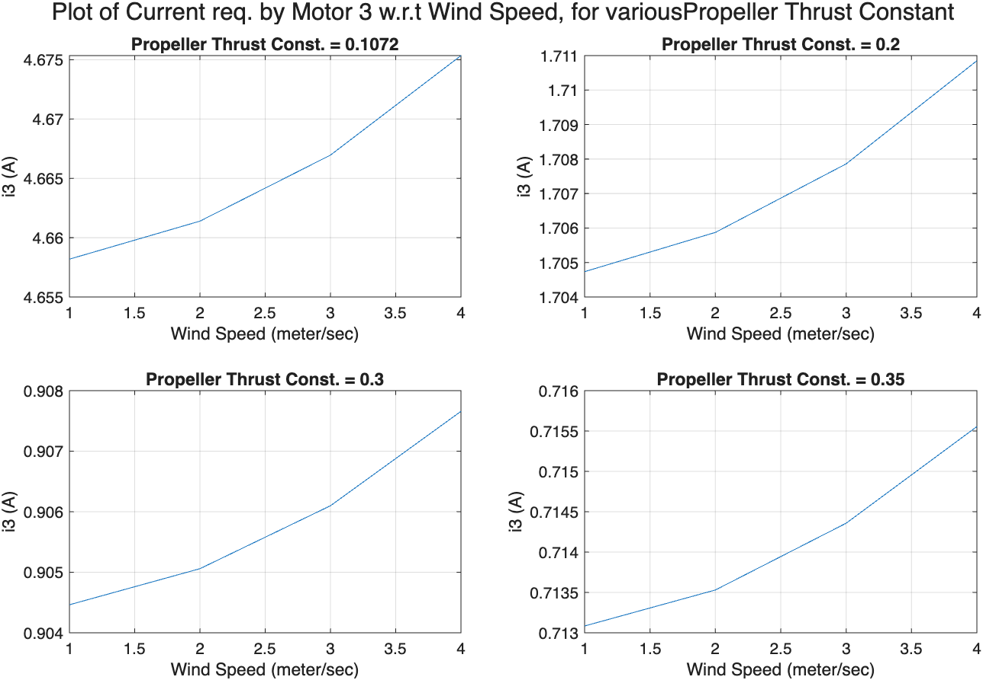
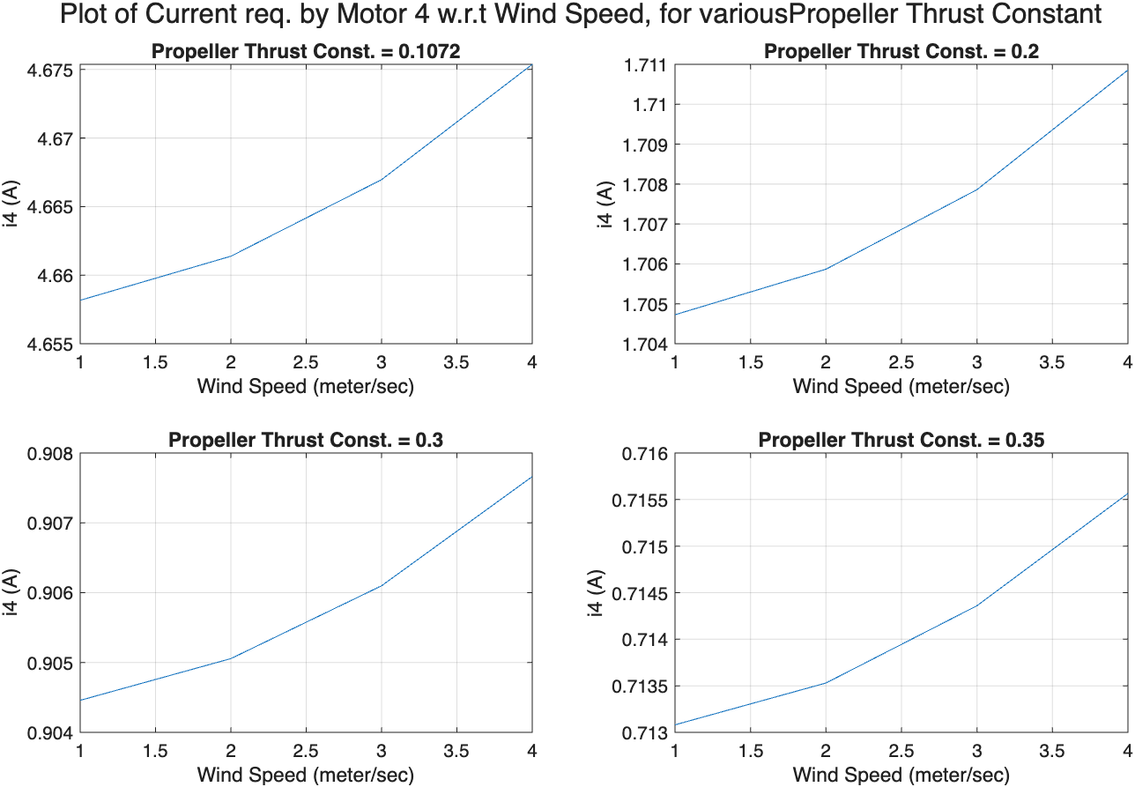
Sensitivity of Current Required by Motor 1 and 2 to Propeller Thrust Constant
The current required by motor 1 and 2, increases with an increase in wind velocity.
However, the current required by motor 1 and 2, decreases with an increase in propeller thrust constant.

Slide 33
Variation in Motor Time Constant

Slide 34


Slide 35





Slide 36





Slide 37





Slide 38





Slide 39
Variation in Drag Coefficient Cd in Y-direction

Slide 40


Slide 41
Variation of Drag Coefficient in Pitch Direction

Slide 42


Slide 43





Slide 44





Slide 45





Slide 46





